Slide 4
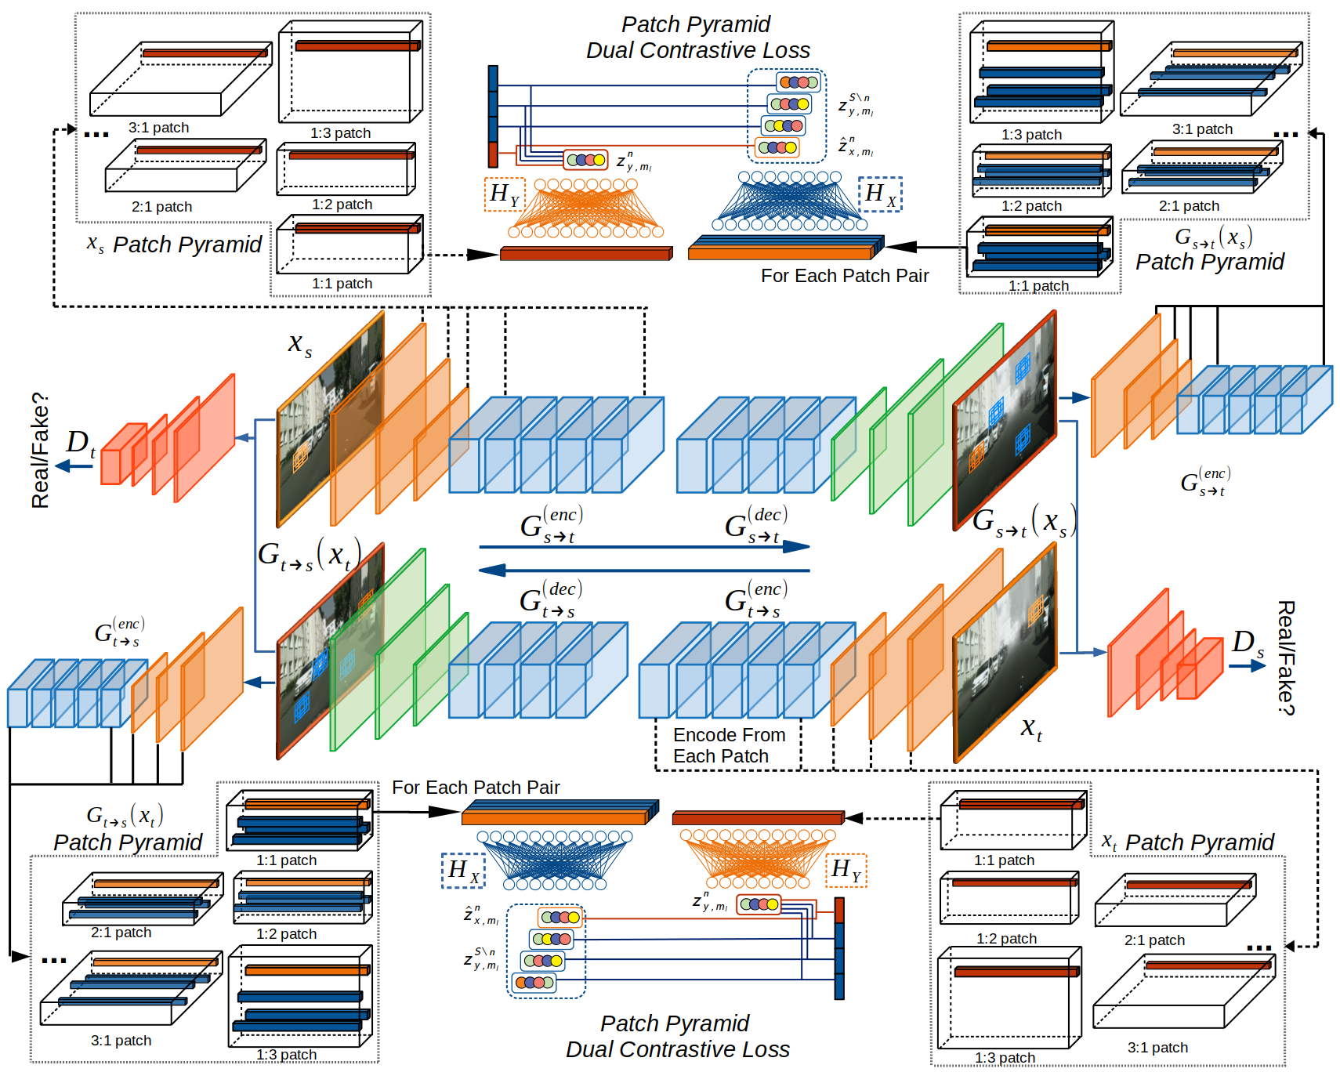

Slide 5
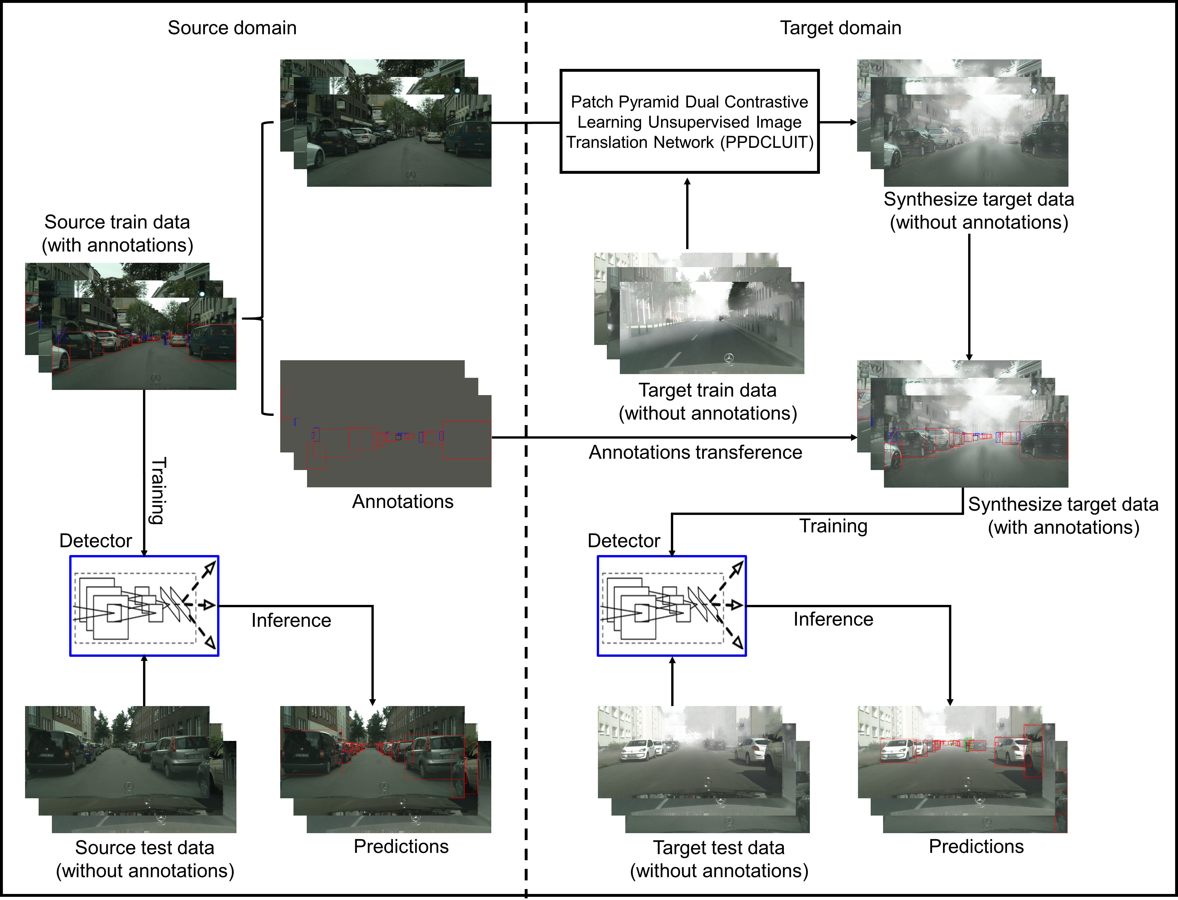

Slide 6

PPDCLUIT Cross-domain Object Detection Framework

Slide 7
PPDCLUIT Network

Slide 8
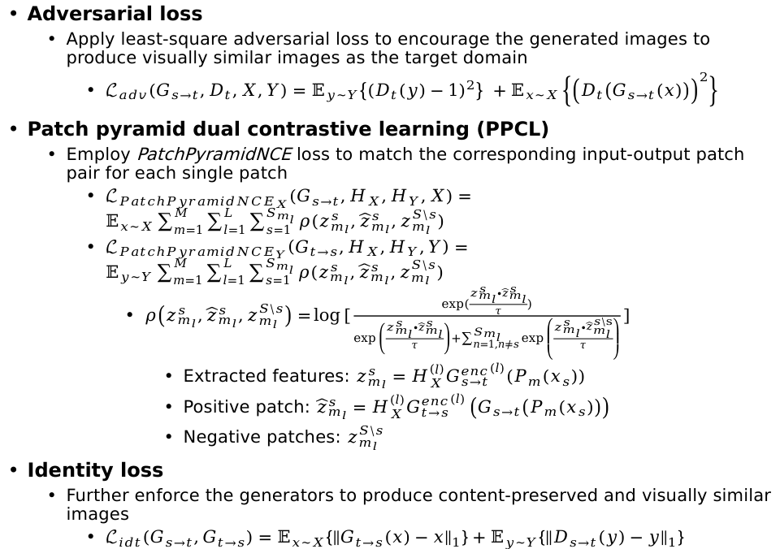
Objectives
Adversarial loss
Apply least-square adversarial loss to encourage the generated images to produce visually similar images as the target domain
$ℒ_{adv}\left(G_{s→t},D_{t},X,Y\right)=𝔼_{y\sim Y}\left\{{\left(D_{t}\left(y\right)−1\right)}^{2}\right\} +𝔼_{x\sim X}\left\{{\left(D_{t}\left(G_{s→t}\left(x\right)\right)\right)}^{2}\right\}$
Patch pyramid dual contrastive learning (PPCL)
Employ PatchPyramidNCE loss to match the corresponding input-output patch pair for each single patch
$ℒ_{{PatchPyramidNCE}_{X}}\left(G_{s→t},H_{X},H_{Y},X\right)=𝔼_{x\sim X}\sum_{m=1}^{M}{\sum_{l=1}^{L}{\sum_{s=1}^{S_{m_{l}}}{ρ(z_{m_{l}}^{s},{\hat{z}}_{m_{l}}^{s},z_{m_{l}}^{S\backslash s})}}}$
$ℒ_{{PatchPyramidNCE}_{Y}}\left(G_{t→s},H_{X},H_{Y},Y\right)=𝔼_{y\sim Y}\sum_{m=1}^{M}{\sum_{l=1}^{L}{\sum_{s=1}^{S_{m_{l}}}{ρ(z_{m_{l}}^{s},{\hat{z}}_{m_{l}}^{s},z_{m_{l}}^{S\backslash s})}}}$
$ρ\left(z_{m_{l}}^{s},{\hat{z}}_{m_{l}}^{s},z_{m_{l}}^{S\backslash s}\right)=\log{[\frac{exp(\frac{z_{m_{l}}^{s}∙{\hat{z}}_{m_{l}}^{s}}{τ})}{exp\left(\frac{z_{m_{l}}^{s}∙{\hat{z}}_{m_{l}}^{s}}{τ}\right)+\sum_{n=1,n≠s}^{S_{m_{l}}}{exp\left(\frac{z_{m_{l}}^{s}∙{\hat{z}}_{m_{l}}^{s\backslash s}}{τ}\right)}}]}$
Extracted features: $z_{m_{l}}^{s}=H_{X}^{\left(l\right)}{G_{s→t}^{enc}}^{\left(l\right)}(P_{m}(x_{s}))$
Positive patch: ${\hat{z}}_{m_{l}}^{s}=H_{X}^{\left(l\right)}{G_{t→s}^{enc}}^{\left(l\right)}\left(G_{s→t}\left(P_{m}\left(x_{s}\right)\right)\right)$
Negative patches: $z_{m_{l}}^{S\backslash s}$
Identity loss
Further enforce the generators to produce content-preserved and visually similar images
$ℒ_{idt}\left(G_{s→t},G_{t→s}\right)=𝔼_{x\sim X}\left\{{\left\|G_{t→s}\left(x\right)−x\right\|}_{1}\right\}+𝔼_{y\sim Y}\left\{{\left\|D_{s→t}\left(y\right)−y\right\|}_{1}\right\}$

Slide 9
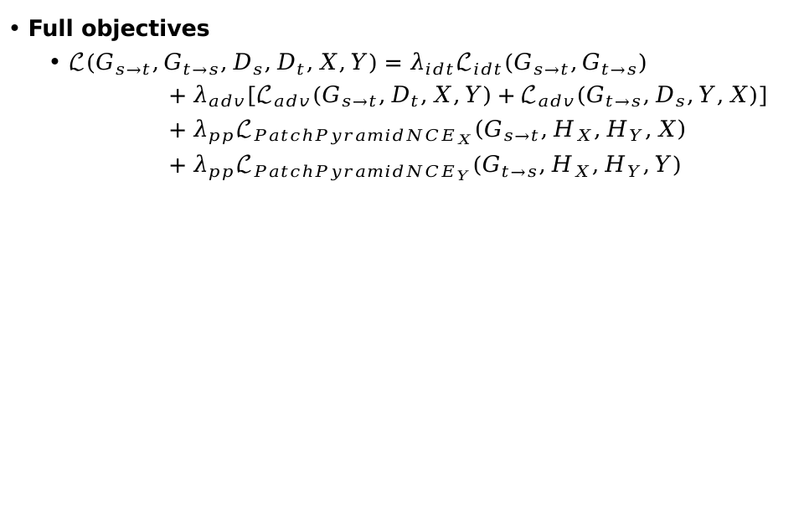
Objectives
Full objectives
$ℒ\left(G_{s→t},G_{t→s},D_{s},D_{t},X,Y\right)=λ_{idt}ℒ_{idt}\left(G_{s→t},G_{t→s}\right)$
$+λ_{adv}\left[ℒ_{adv}\left(G_{s→t},D_{t},X,Y\right)+ℒ_{adv}\left(G_{t→s},D_{s},Y,X\right)\right]$
$+λ_{pp}ℒ_{{PatchPyramidNCE}_{X}}\left(G_{s→t},H_{X},H_{Y},X\right)$
$+{λ_{pp}ℒ}_{{PatchPyramidNCE}_{Y}}\left(G_{t→s},H_{X},H_{Y},Y\right)$

Slide 10
Experiments for Image Translation
Quantitative comparisons for the generated images in the target domain
Our PPDCLUIT consistently achieve superior performance
Method | FID↓ | Precision↑ | Recall↑ | Density↑ | Coverage↑
 | Cityscapes → FoggyCityscapes
Source only | 68.71 | 0.009 | 0.566 | 0.002 | 0.016
CycleGAN | 45.10 | 0.767 | 0.304 | 0.729 | 0.782
CUT | 42.56 | 0.668 | 0.498 | 0.592 | 0.930
DCLGAN | 48.95 | 0.276 | 0.394 | 0.098 | 0.338
PPDCLUIT | 41.96 | 0.167 | 0.688 | 0.053 | 0.340
 | BDD100K Day → Night
Source only | 104.63 | 0.181 | 0.413 | 0.046 | 0.022
CycleGAN | 17.90 | 0.763 | 0.594 | 0.828 | 0.729
CUT | 24.17 | 0.711 | 0.673 | 0.681 | 0.658
DCLGAN | 21.92 | 0.784 | 0.485 | 0.965 | 0.633
PPDCLUIT | 14.11 | 0.842 | 0.566 | 1.265 | 0.806

Slide 11
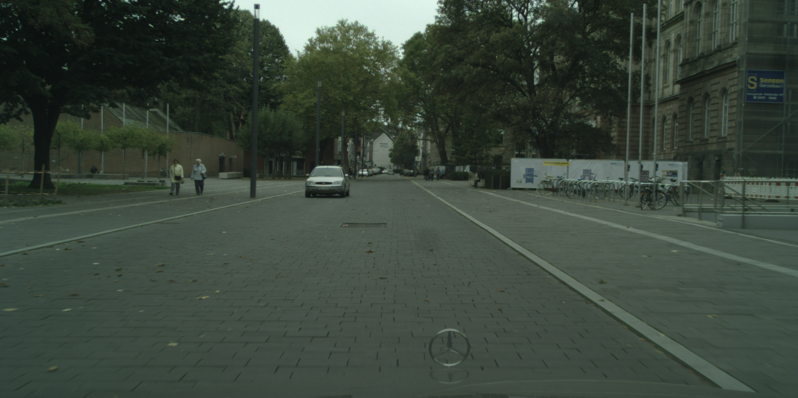
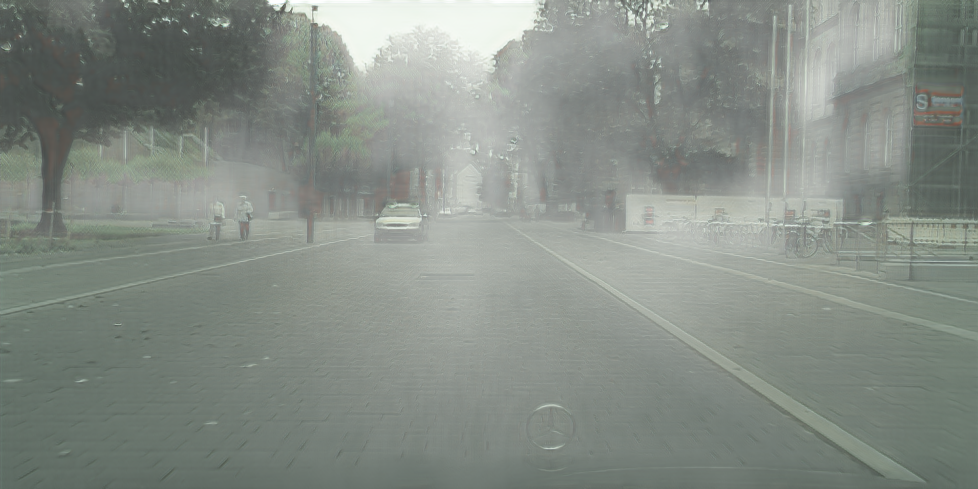
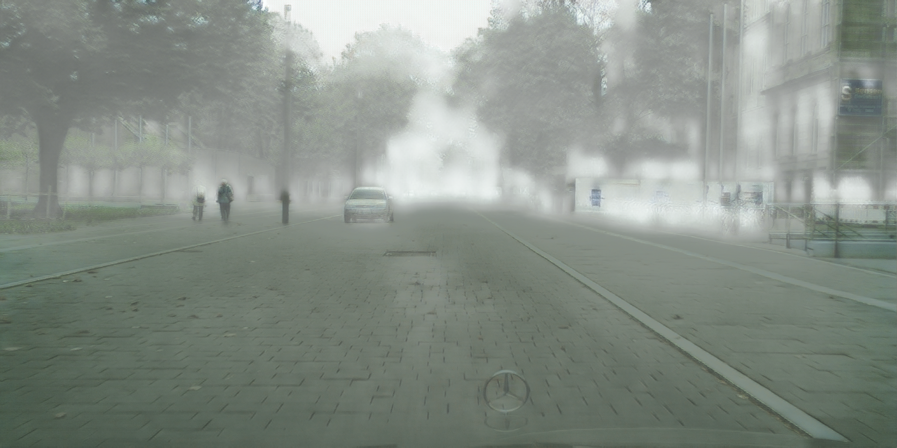
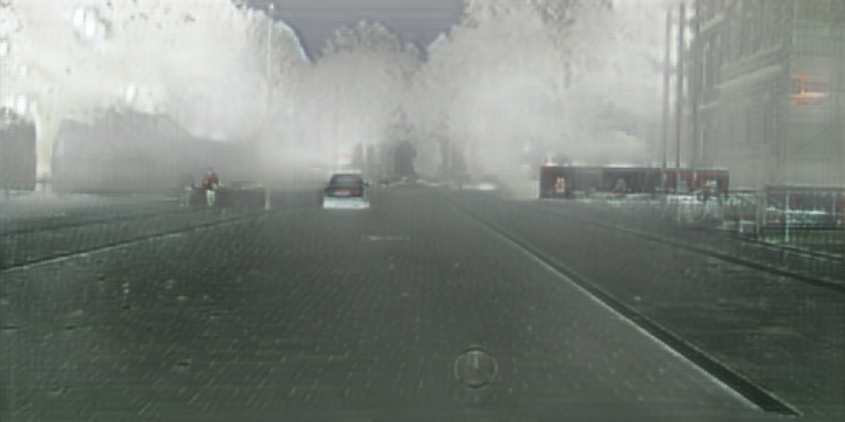
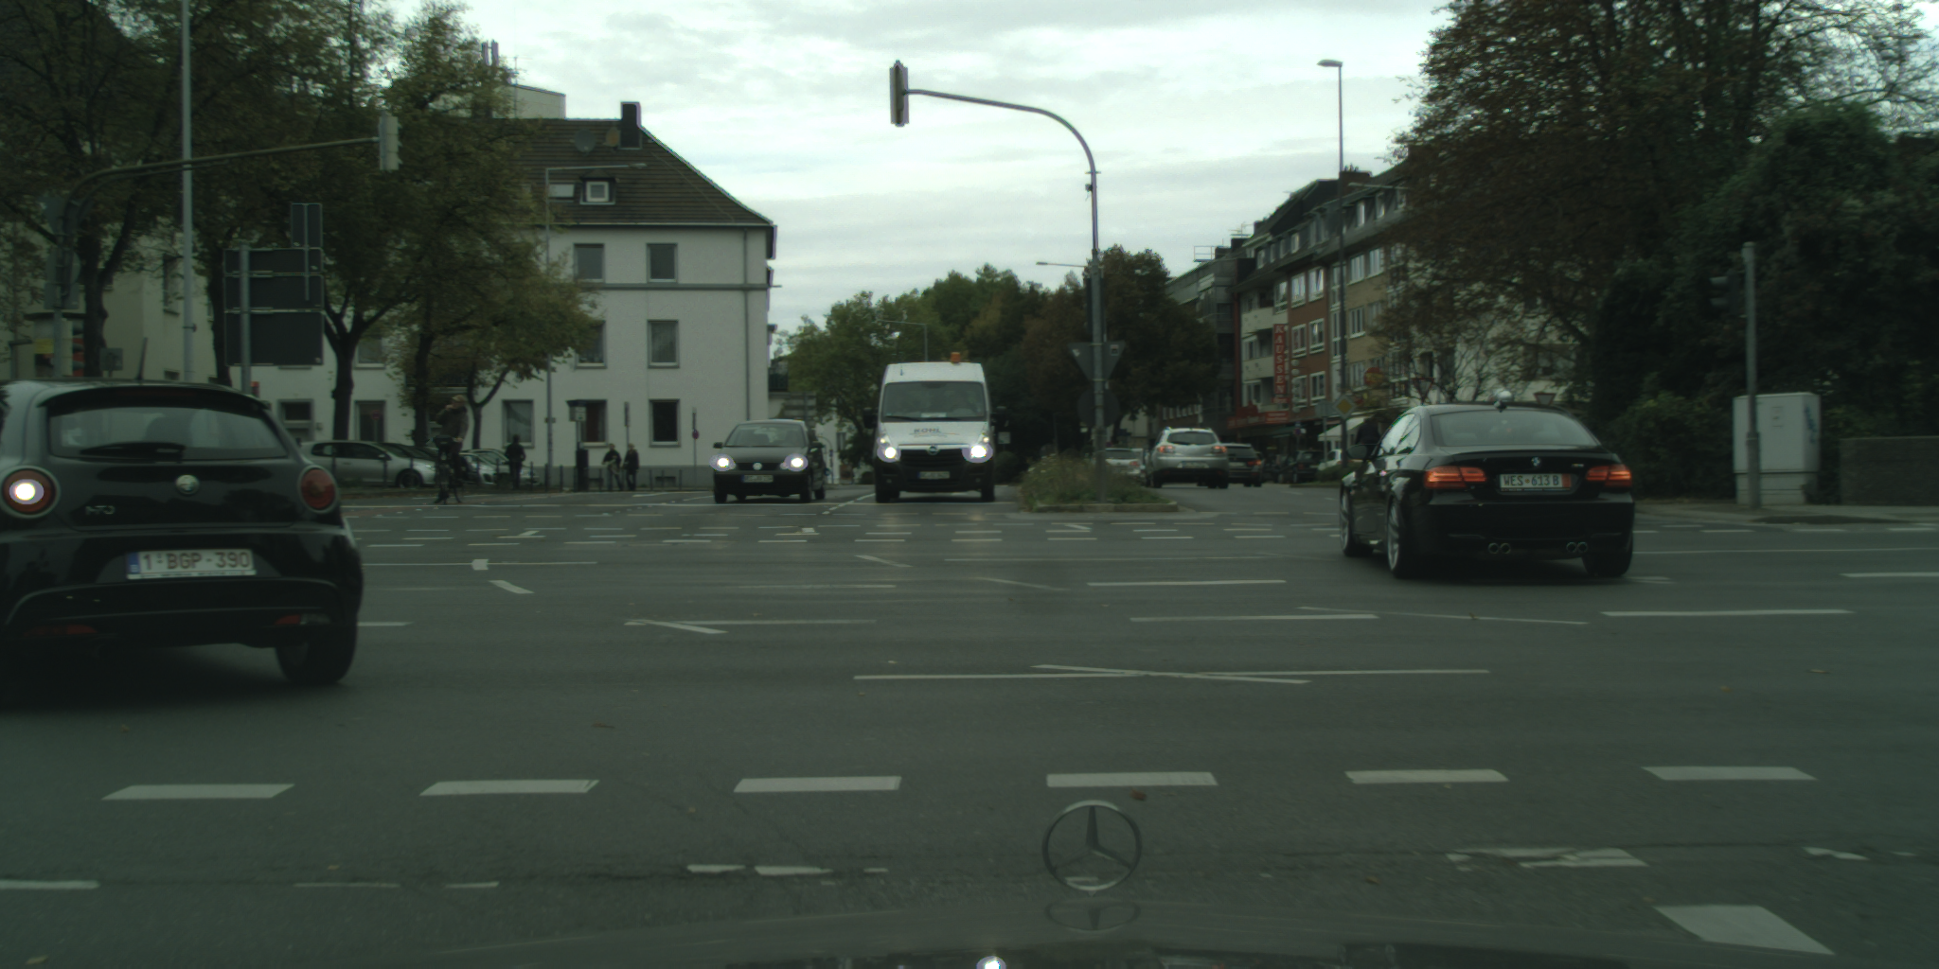
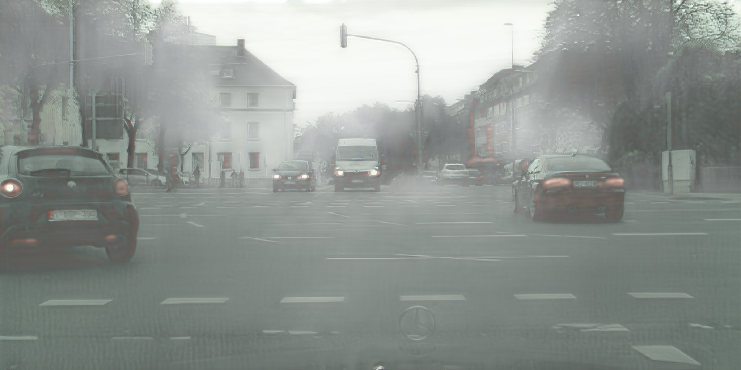
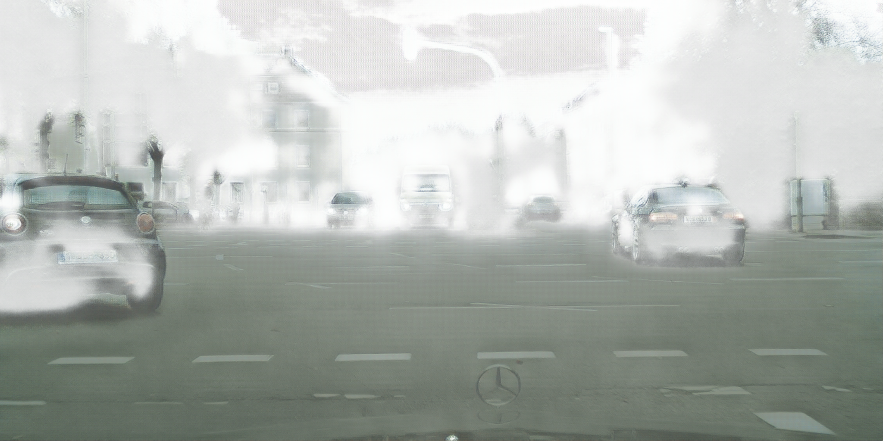
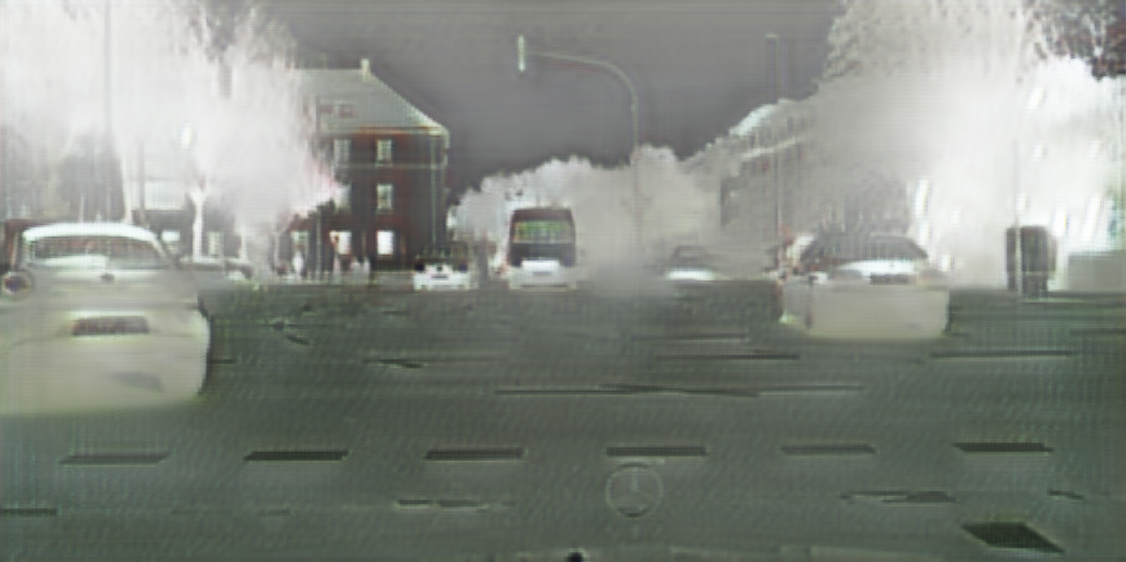
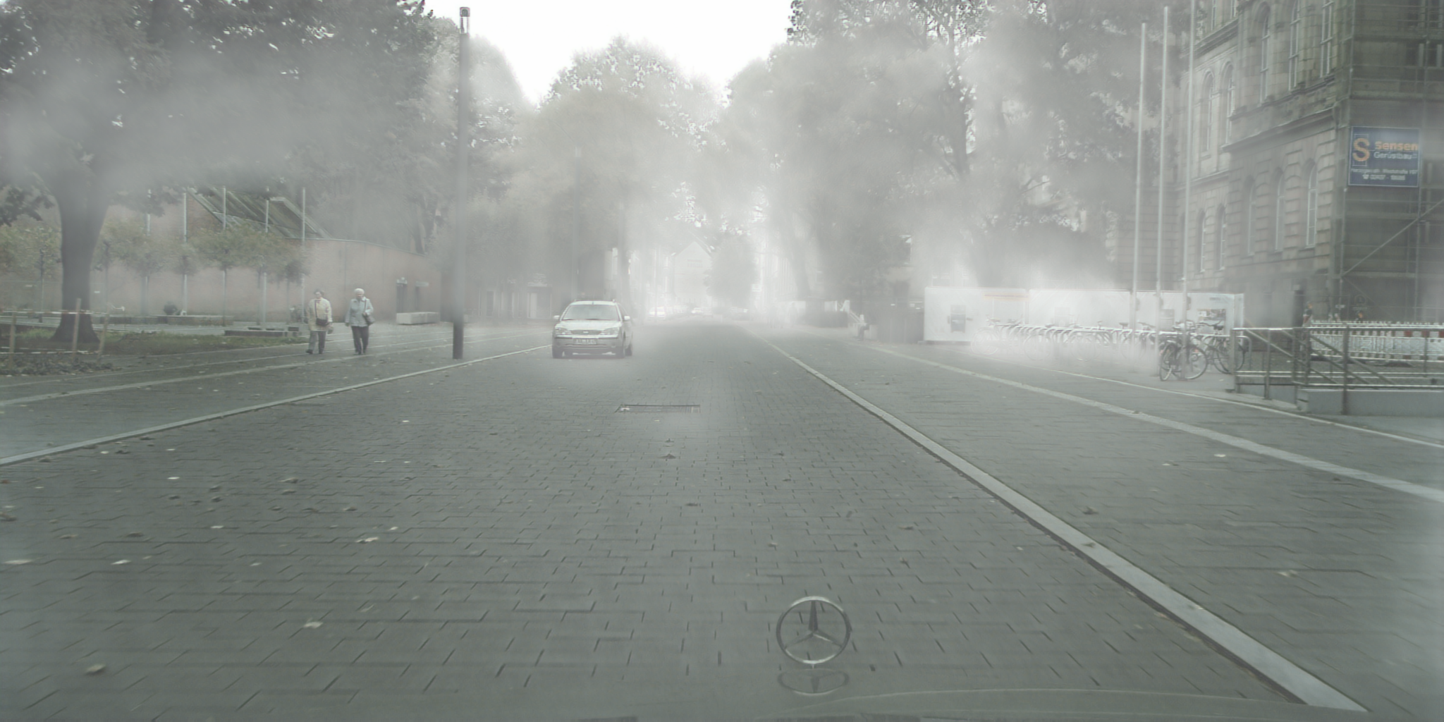
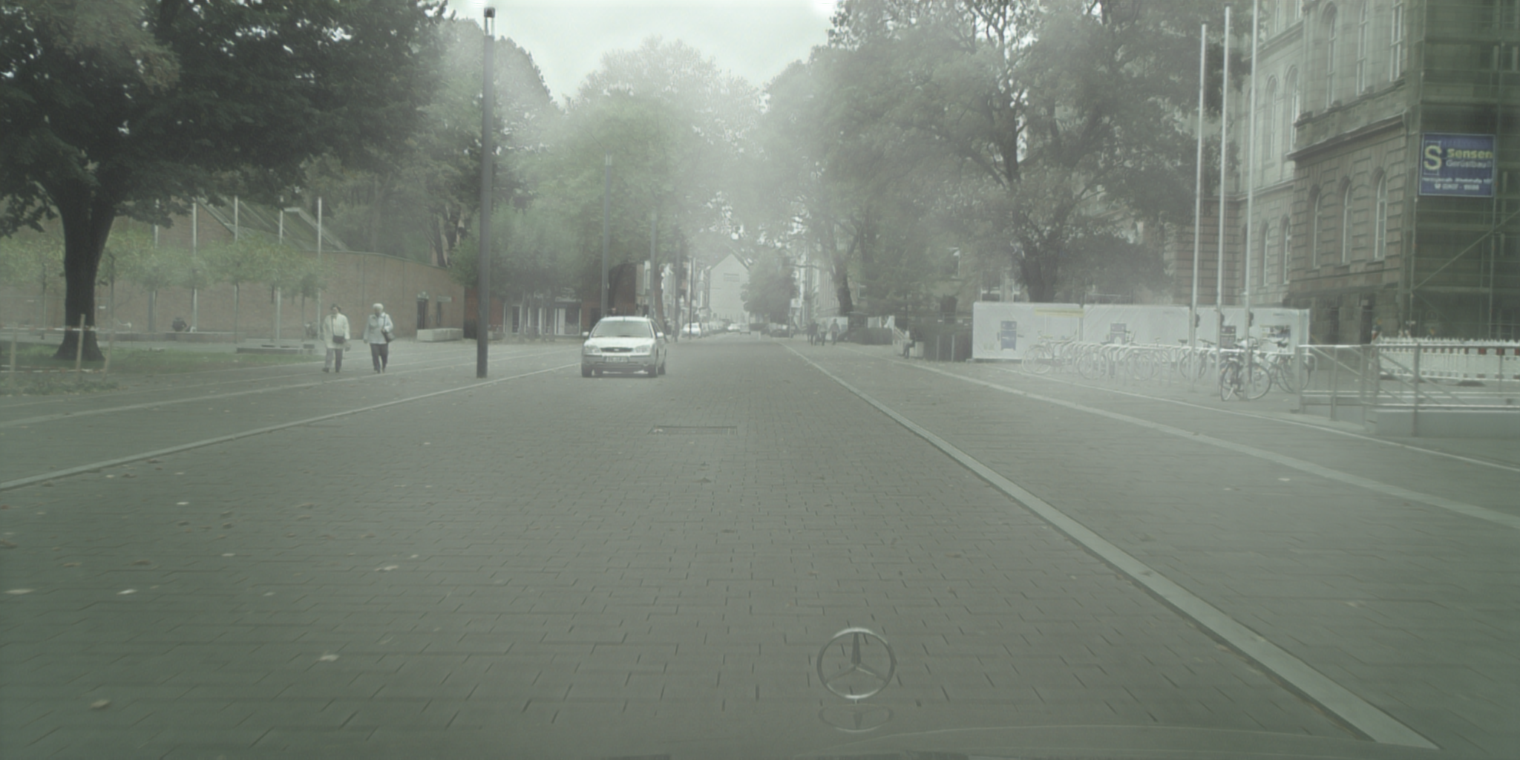
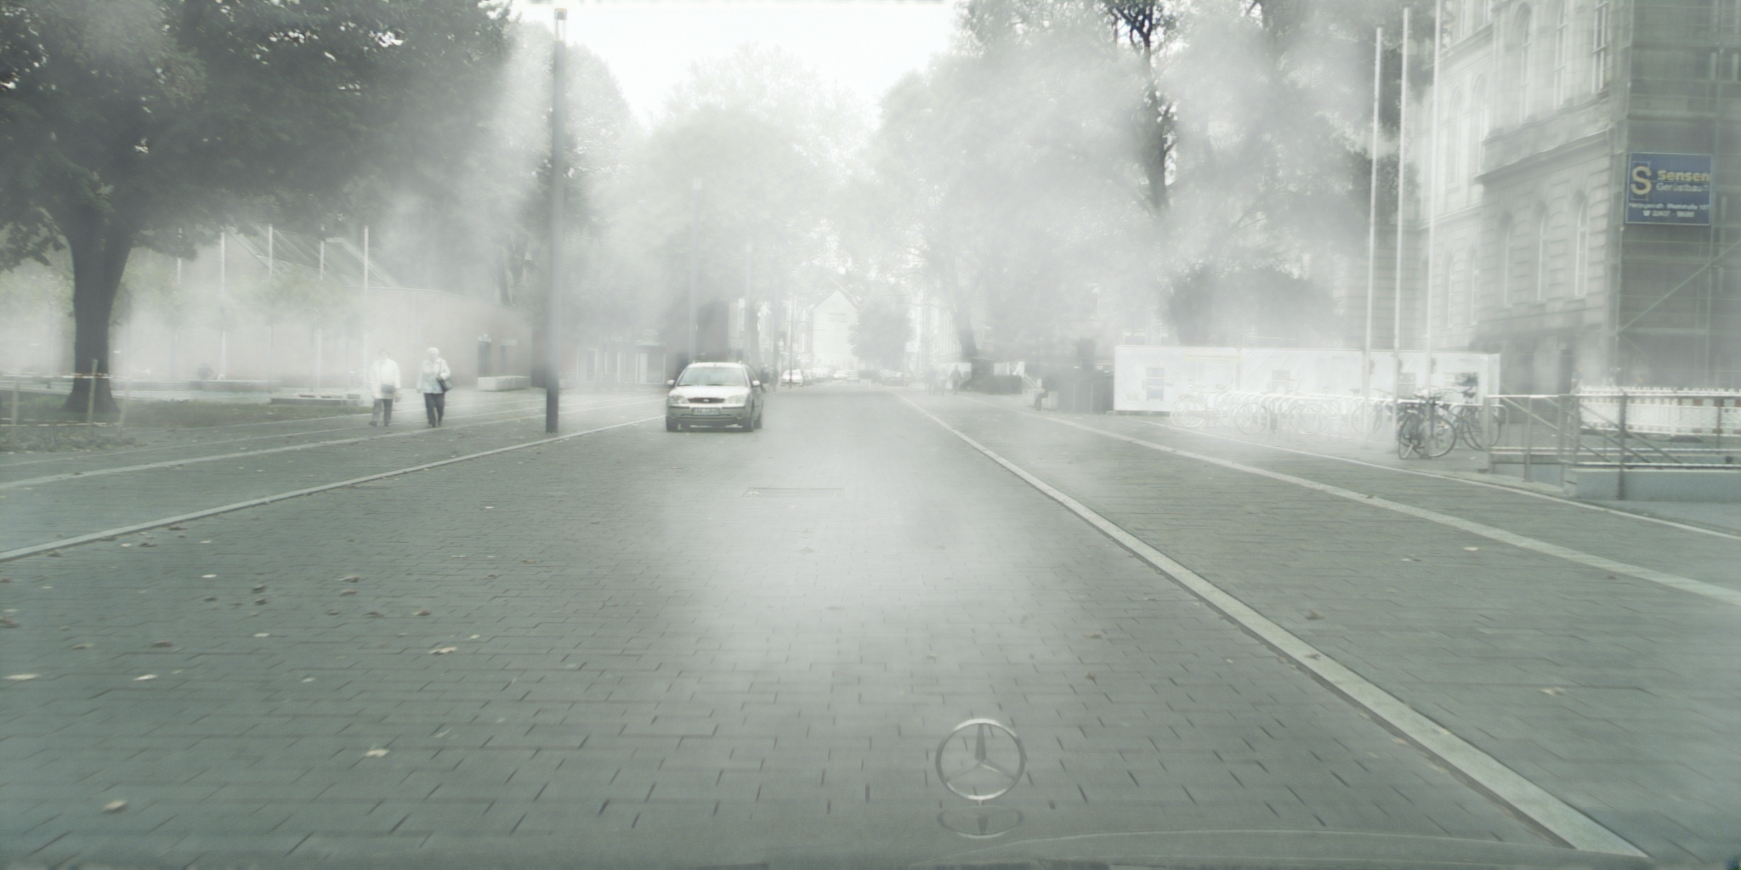
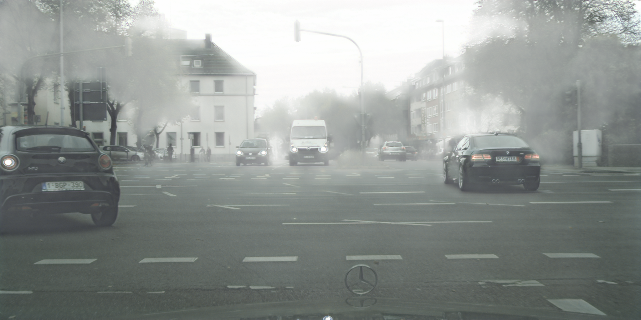
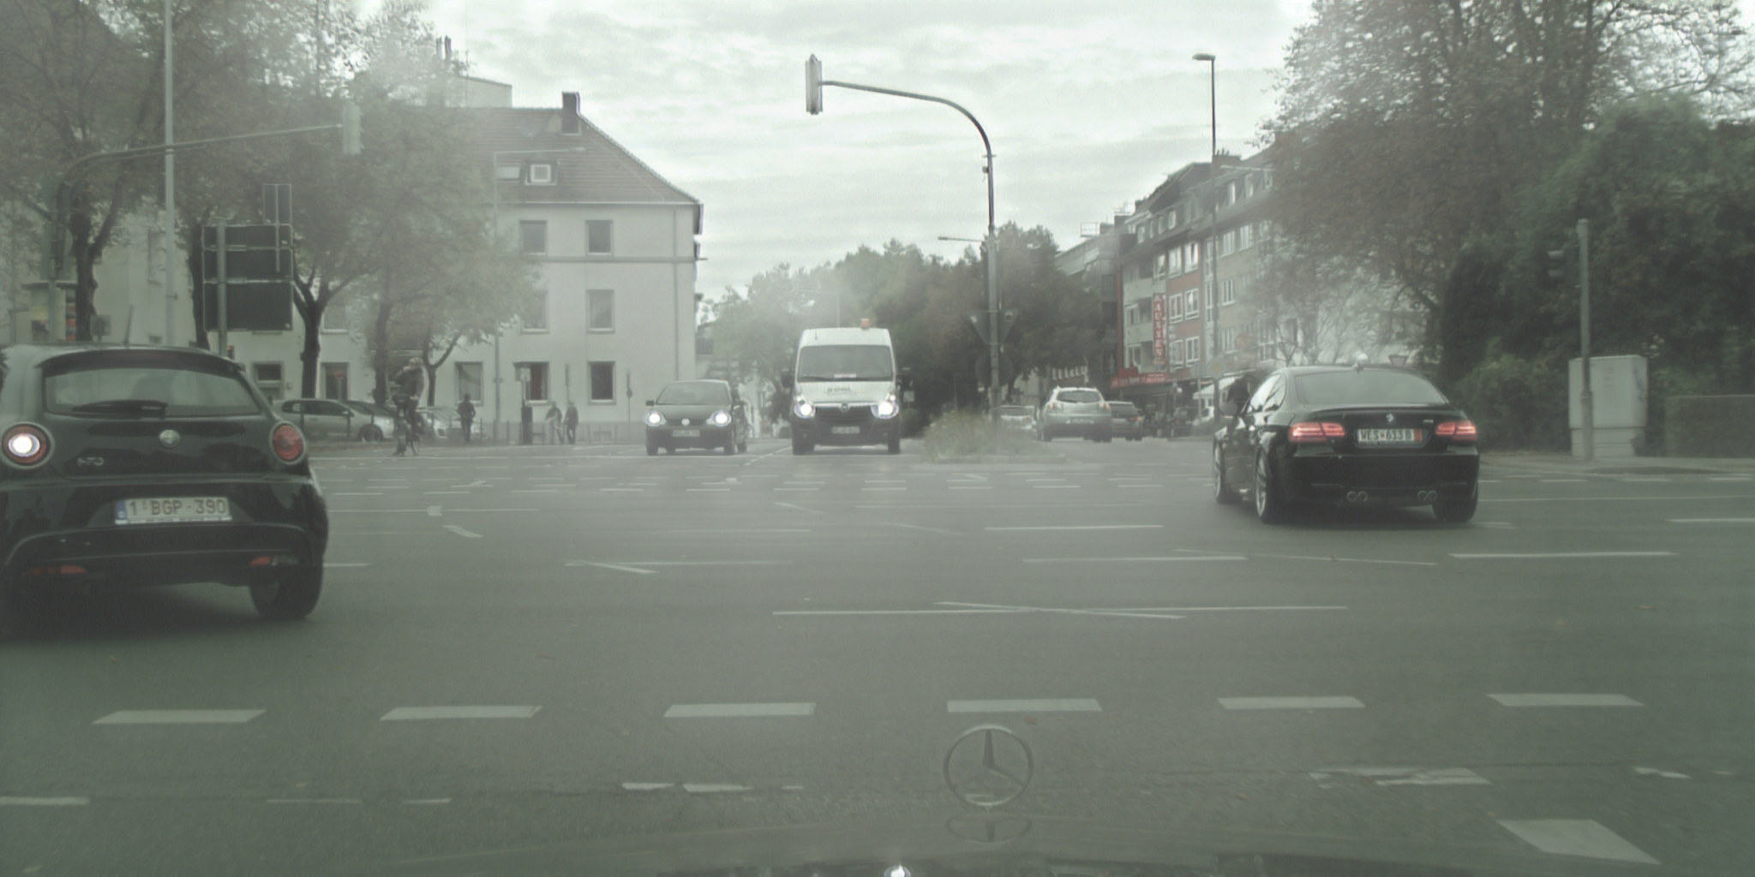
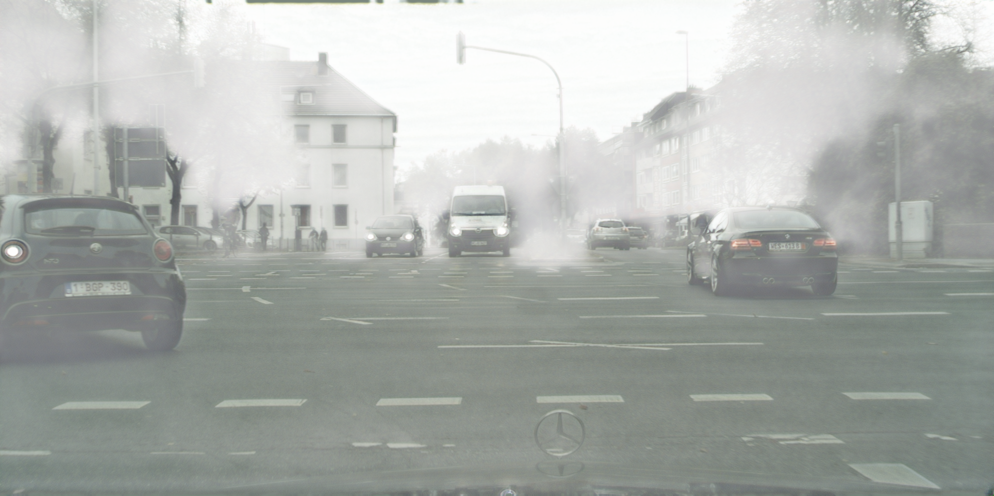
Experiments (Normal-to-Foggy)
Qualitative comparisons of the translation results
Our PPDCLUIT reach promising visual results
Input
CycleGAN
DRIT
ForkGAN
CUT
DCLGAN
PPDCLUIT

Slide 13
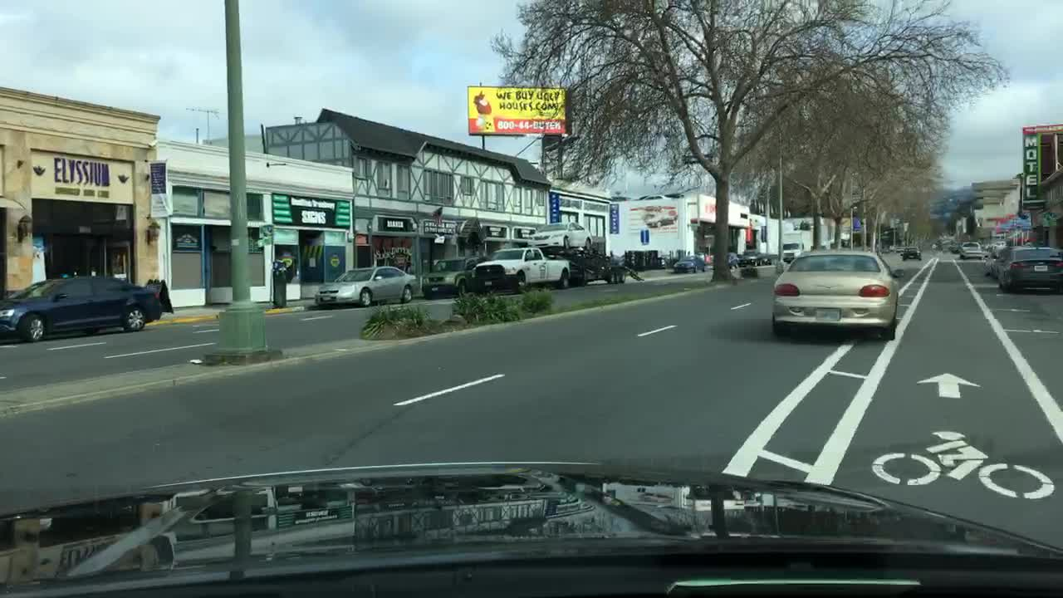
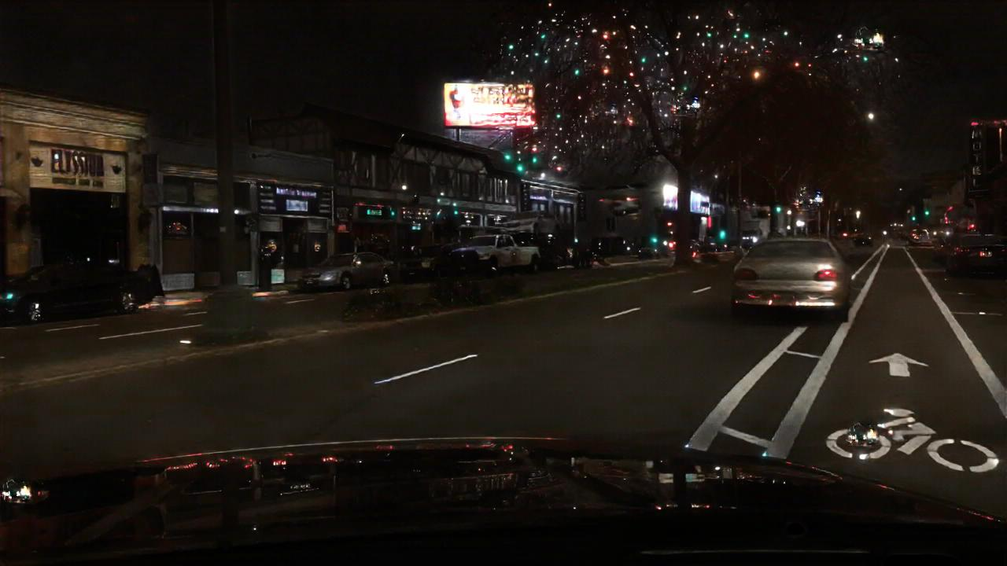
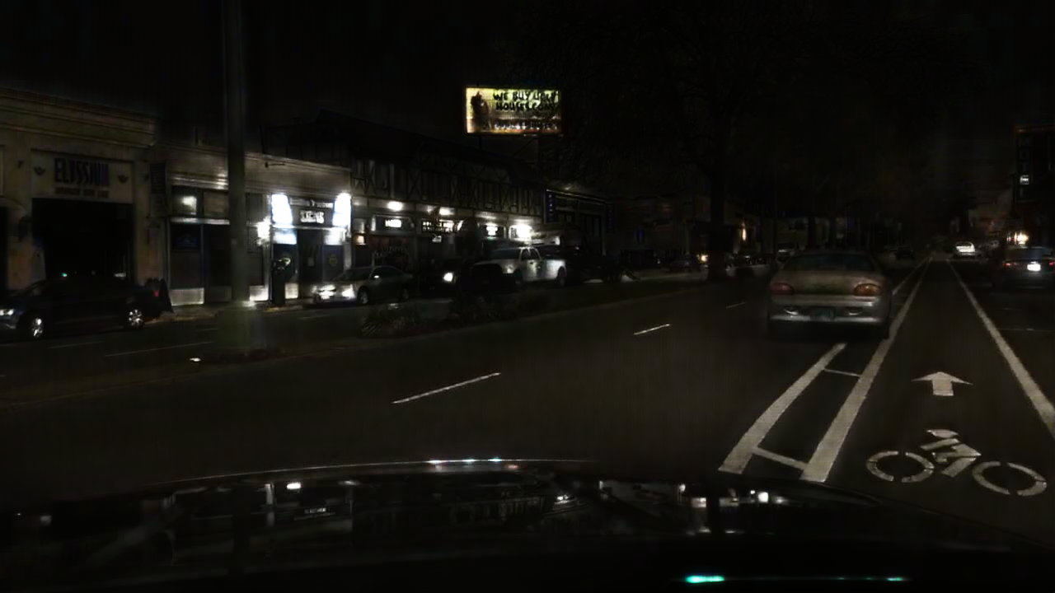
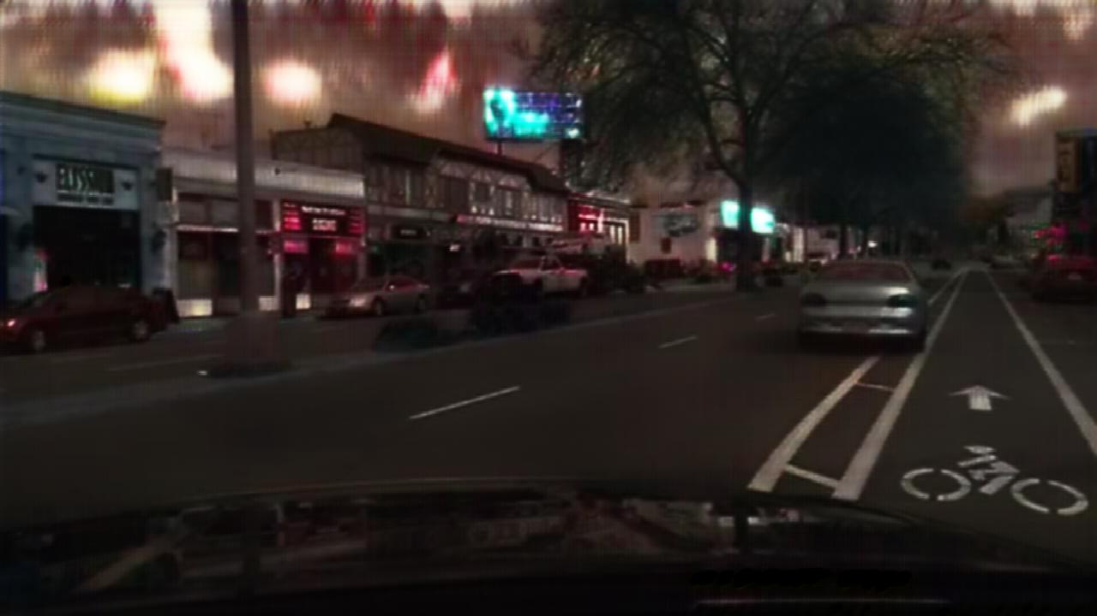
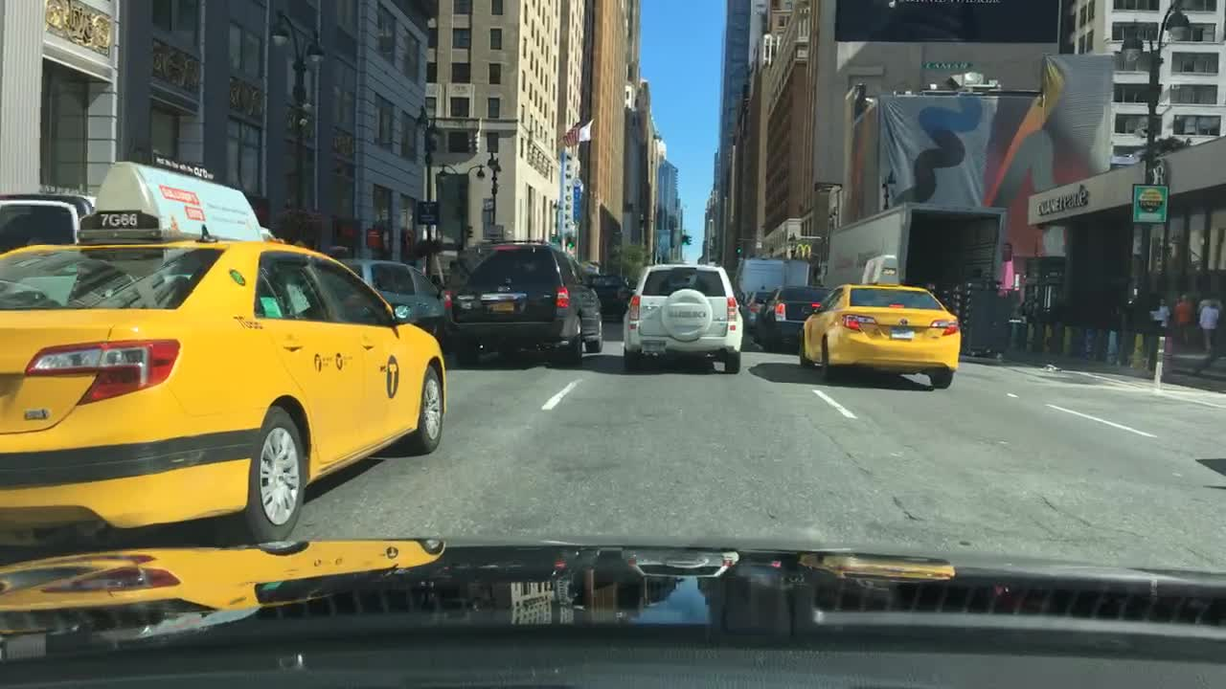
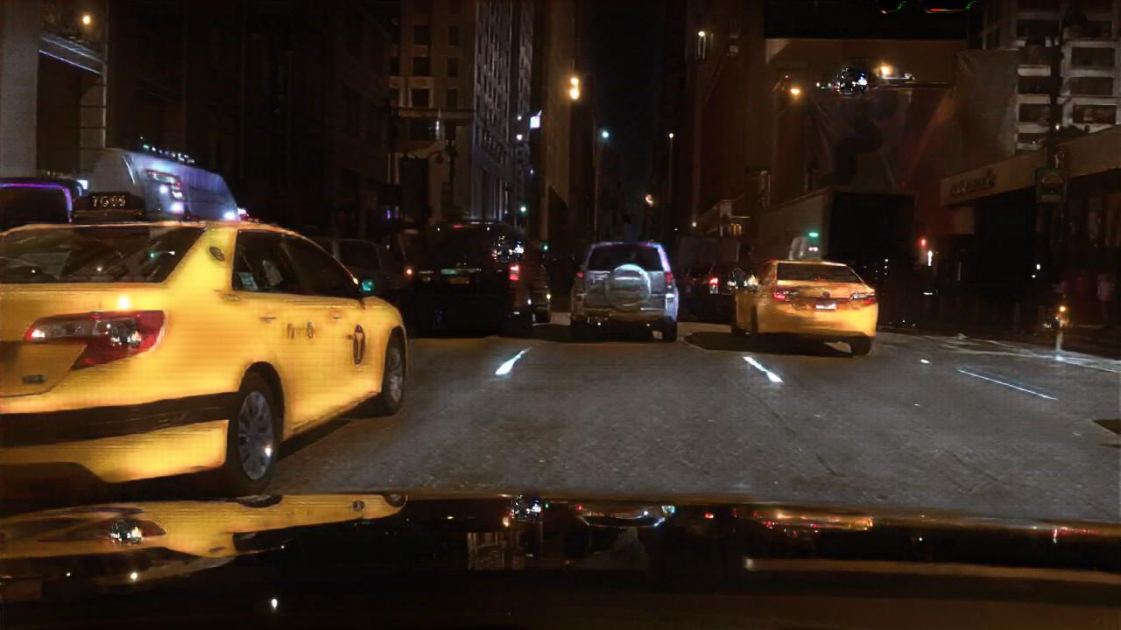
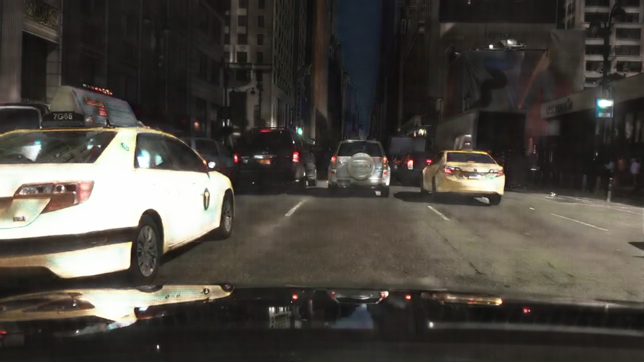
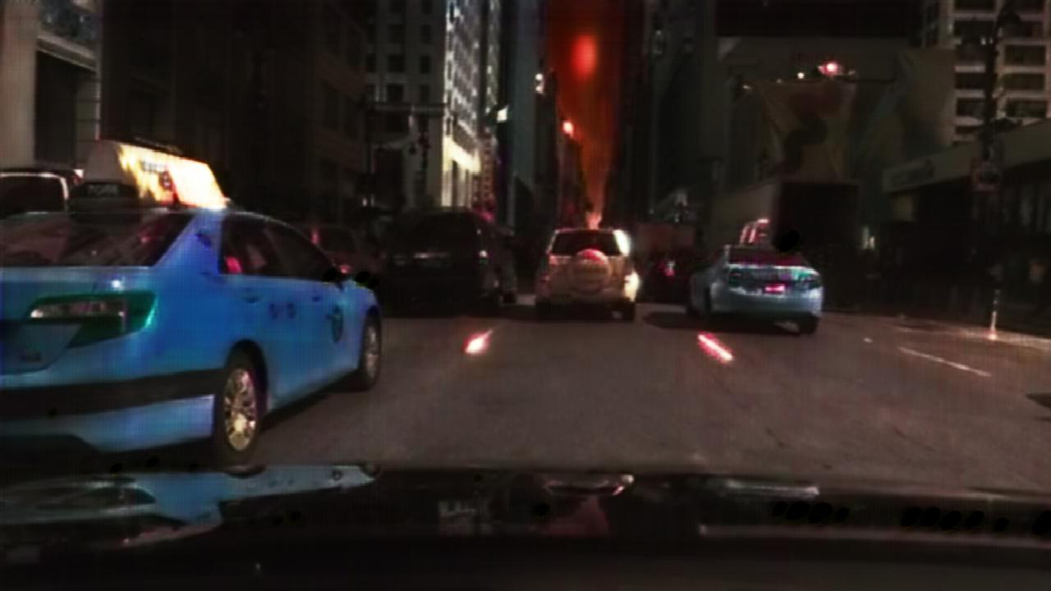
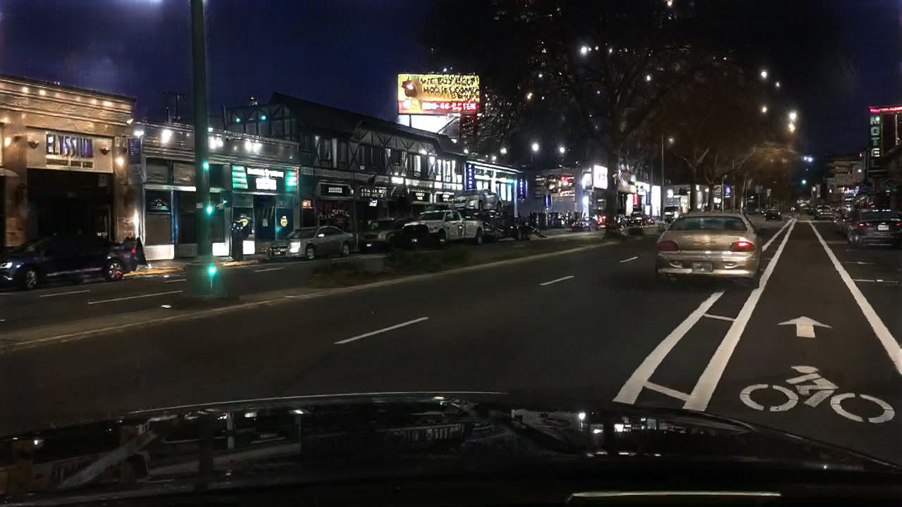
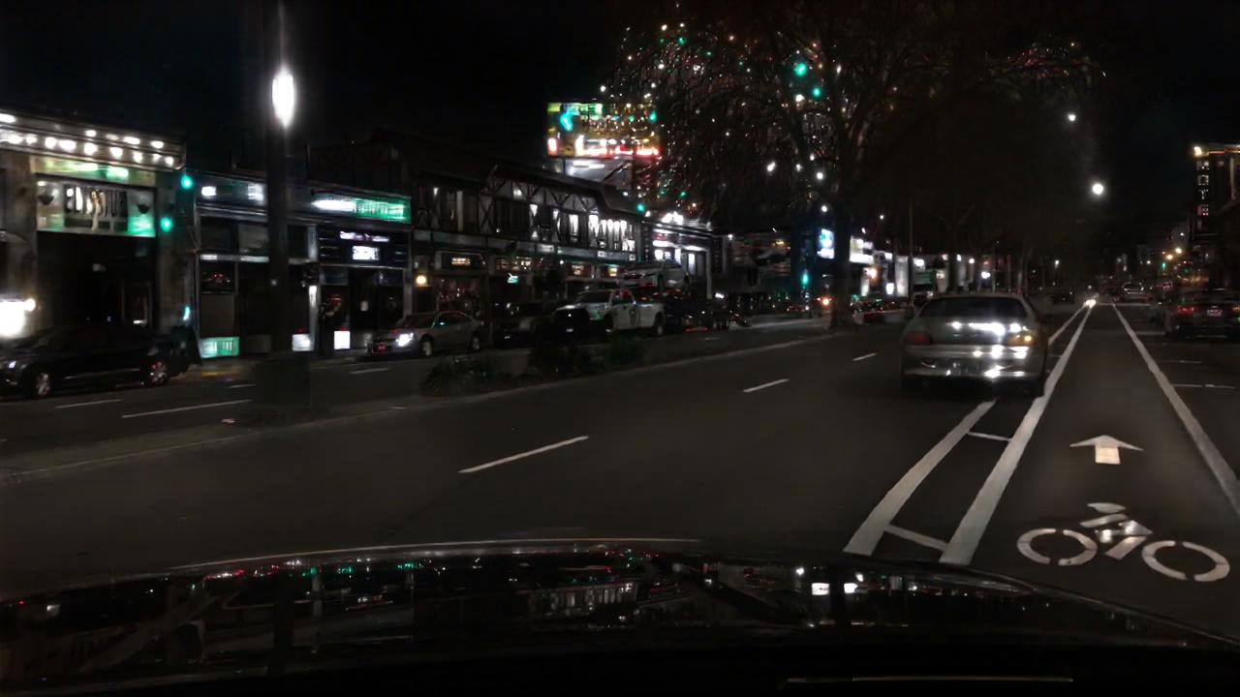
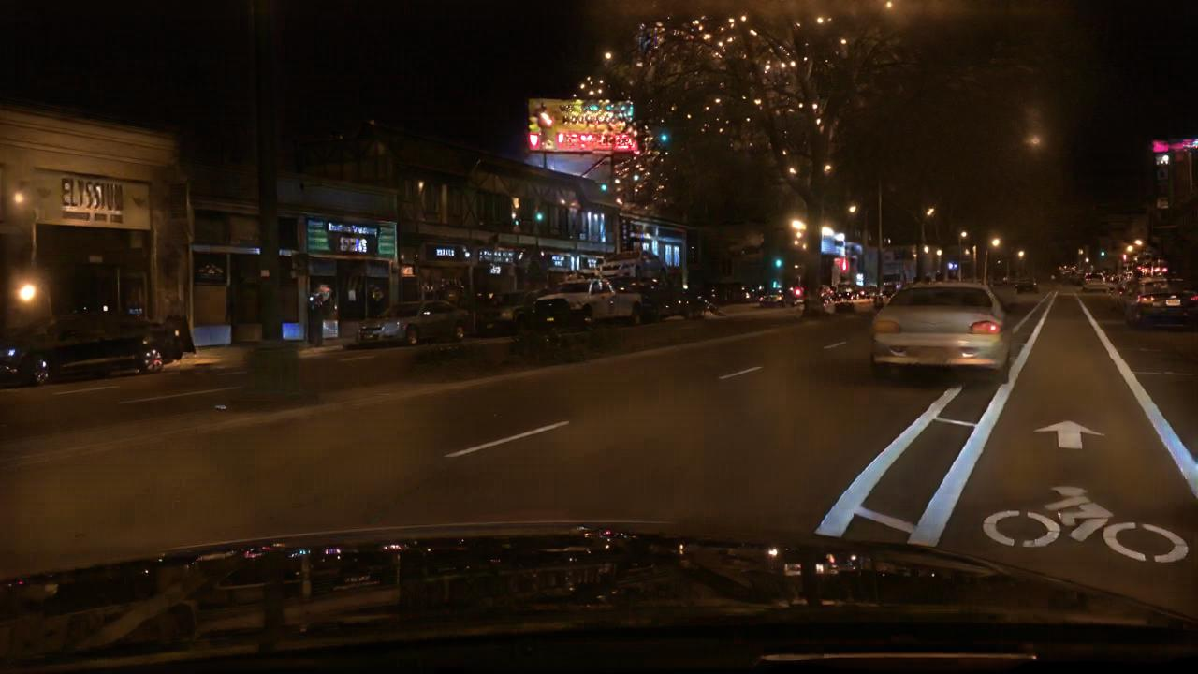
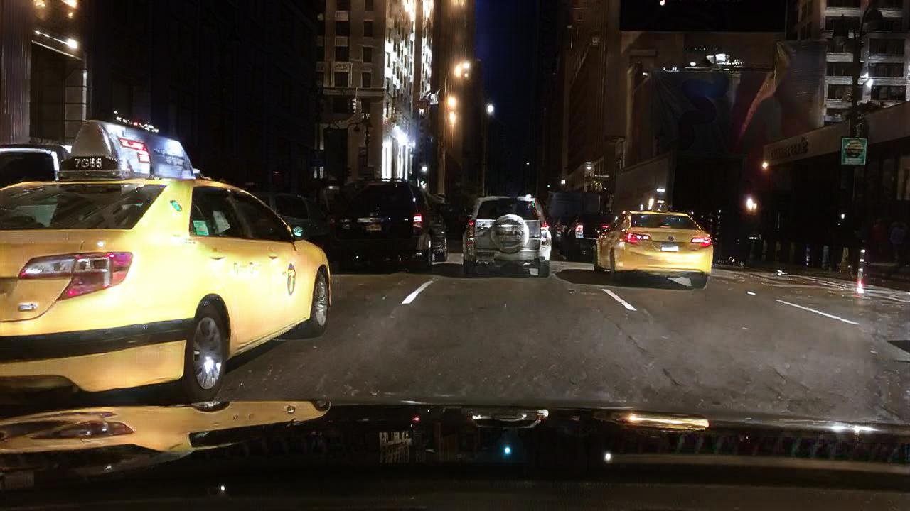
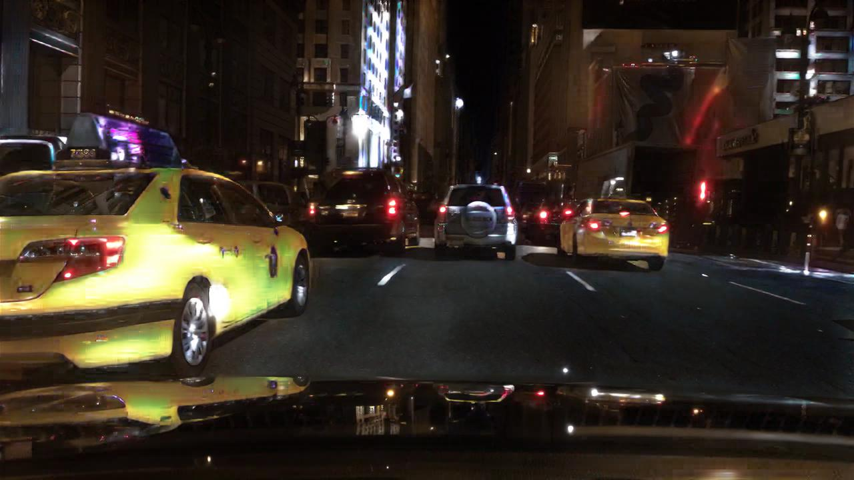
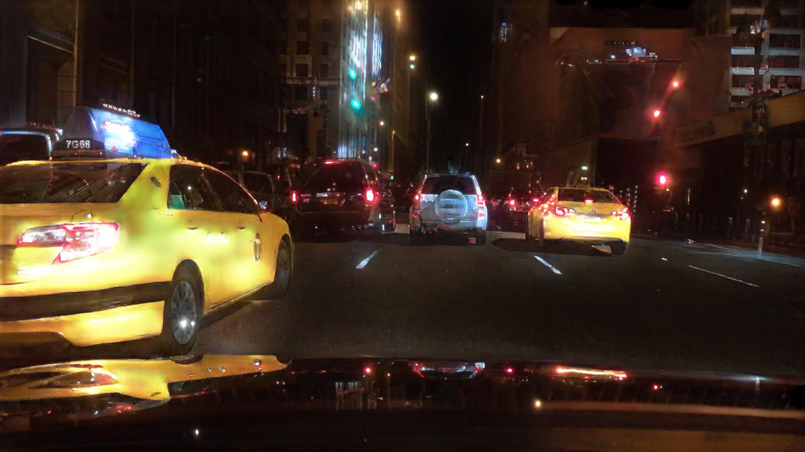
Experiments (Day-to-Night)
Qualitative comparisons of the translation results
Our PPDCLUIT reach promising visual results
Input
CycleGAN
DRIT
ForkGAN
CUT
DCLGAN
PPDCLUIT

Slide 14
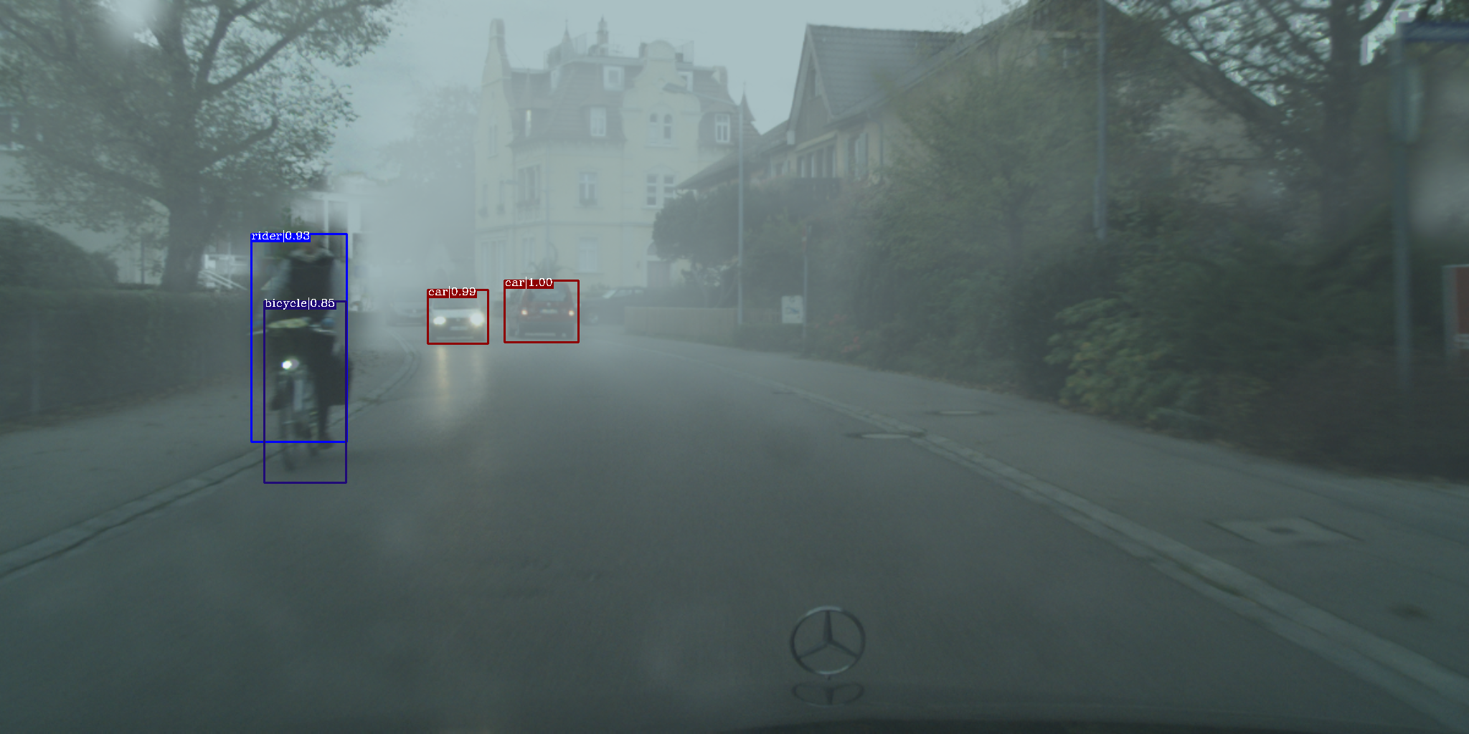
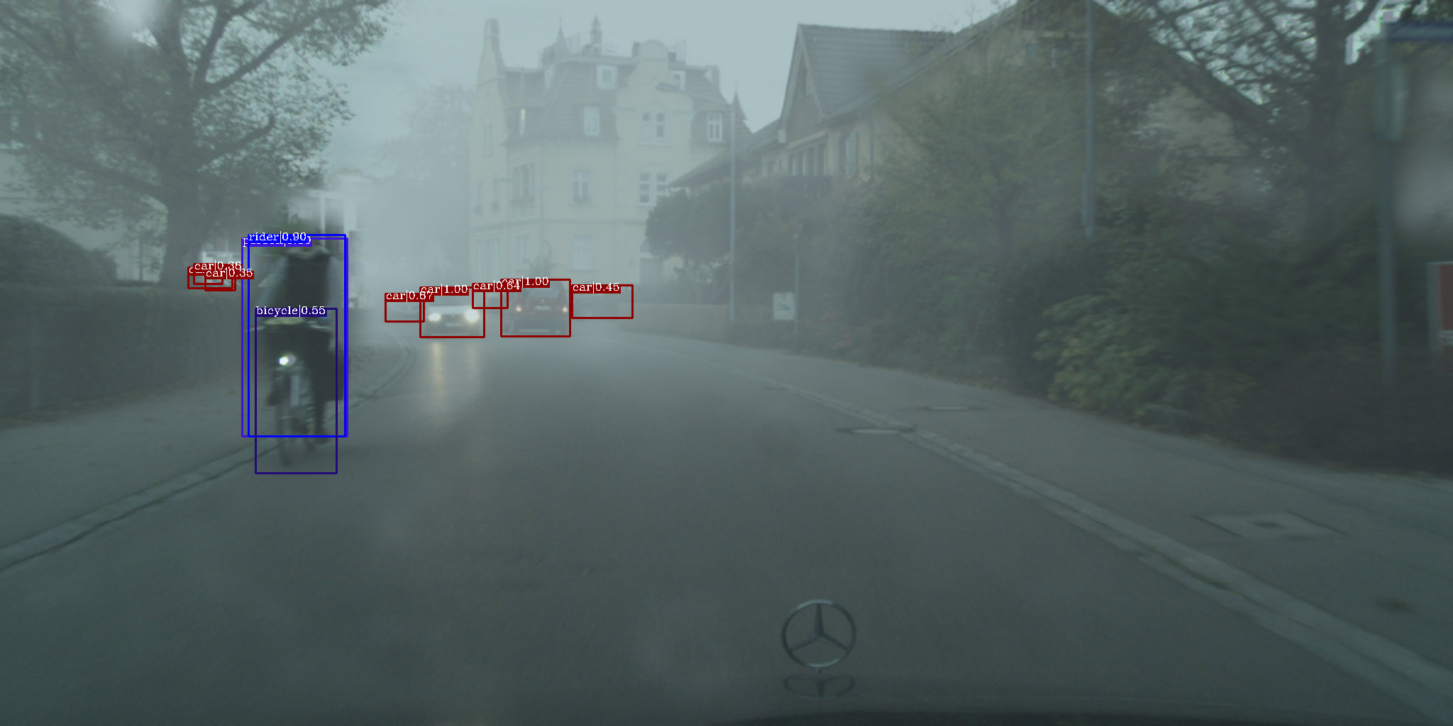
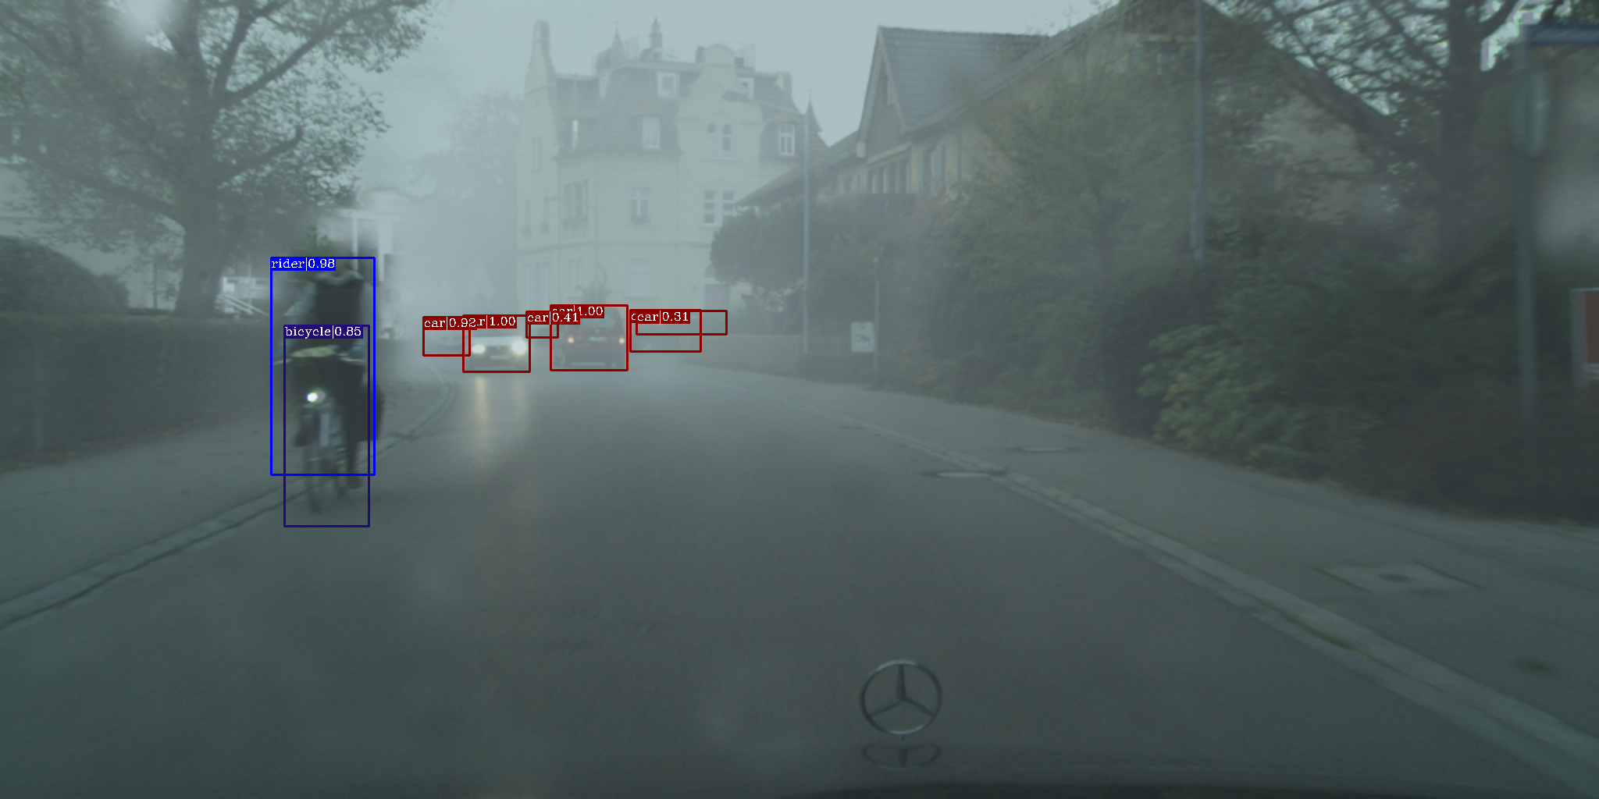
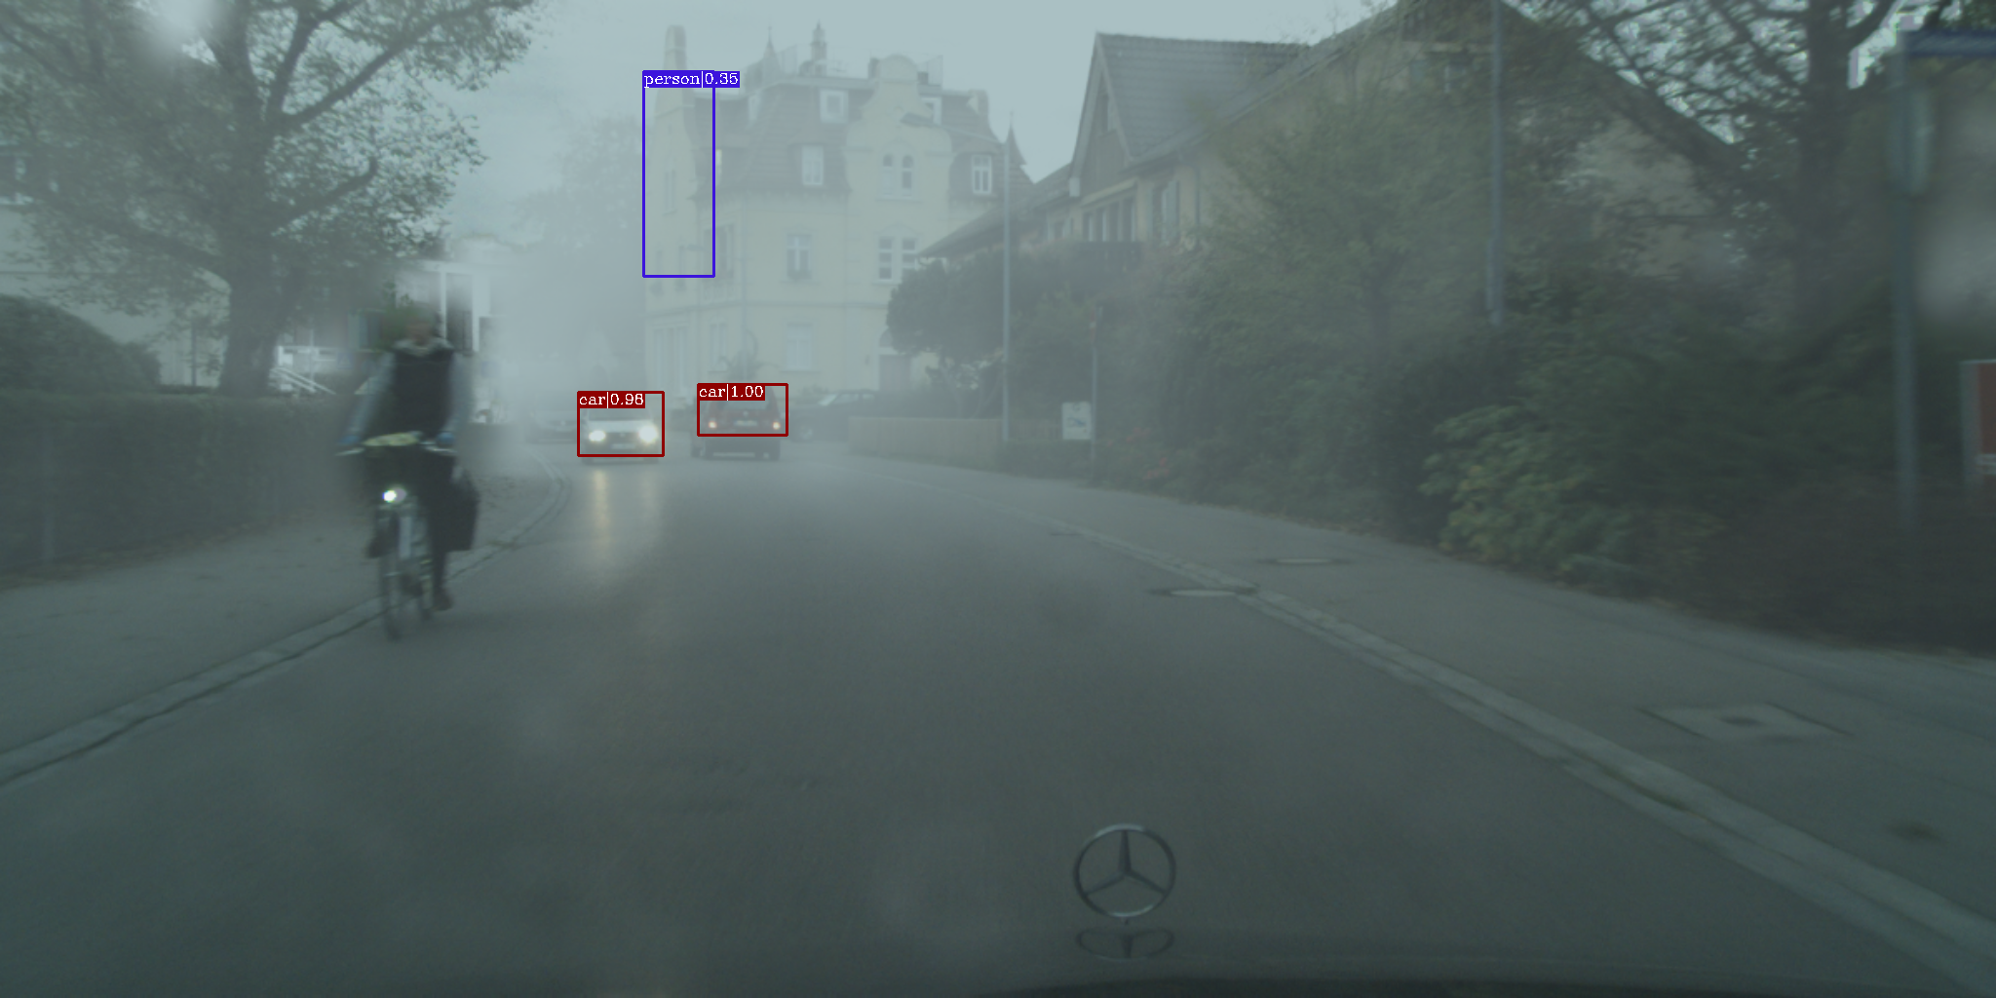
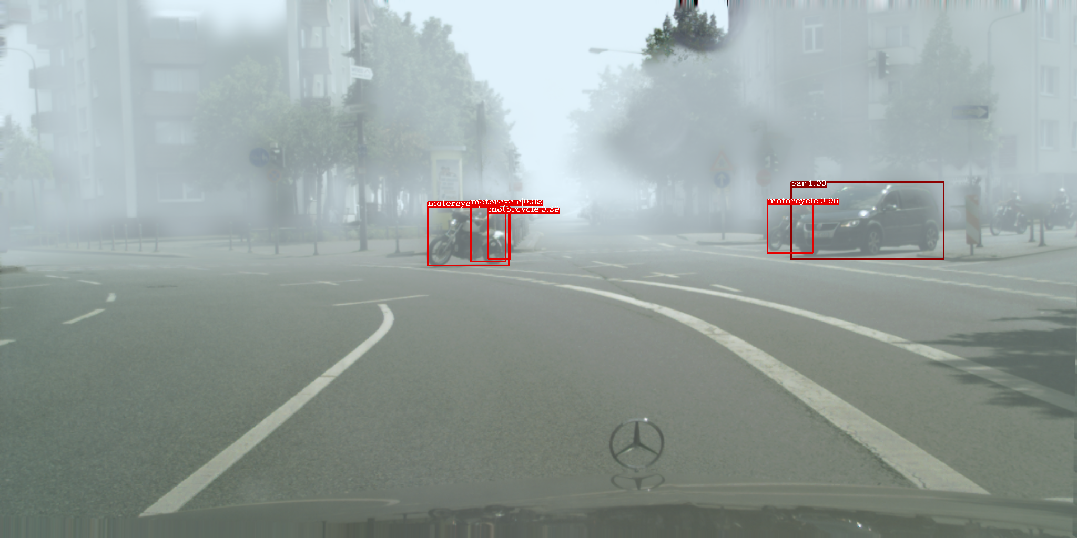
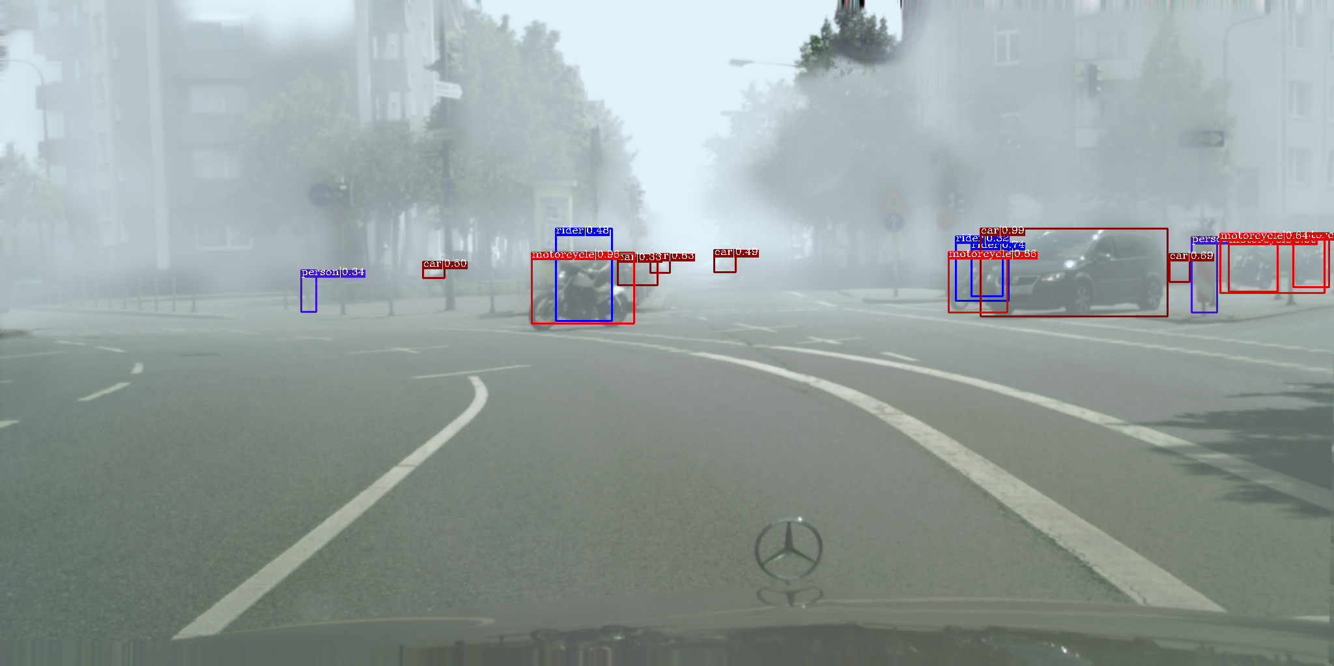
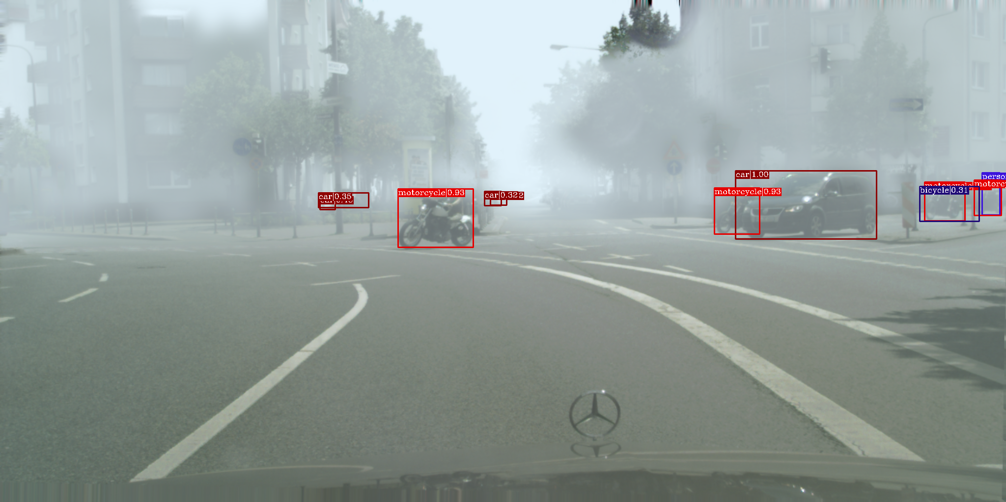
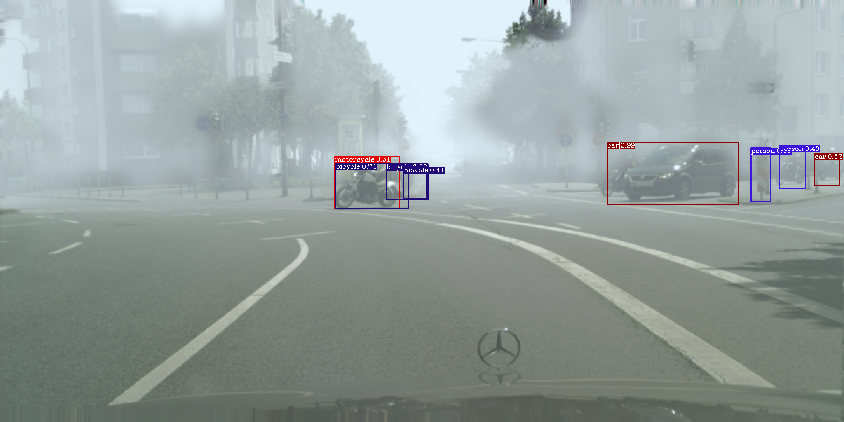
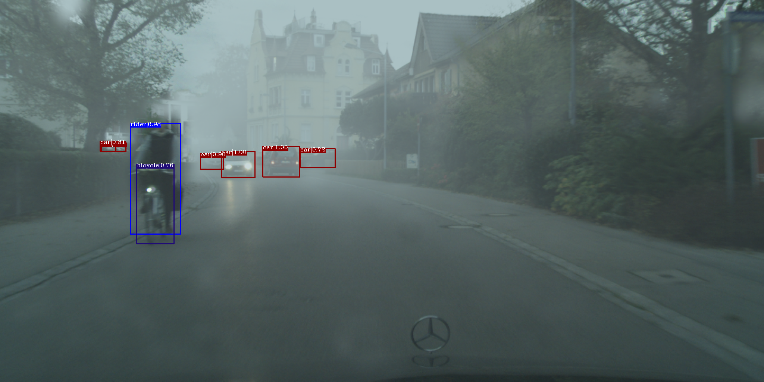
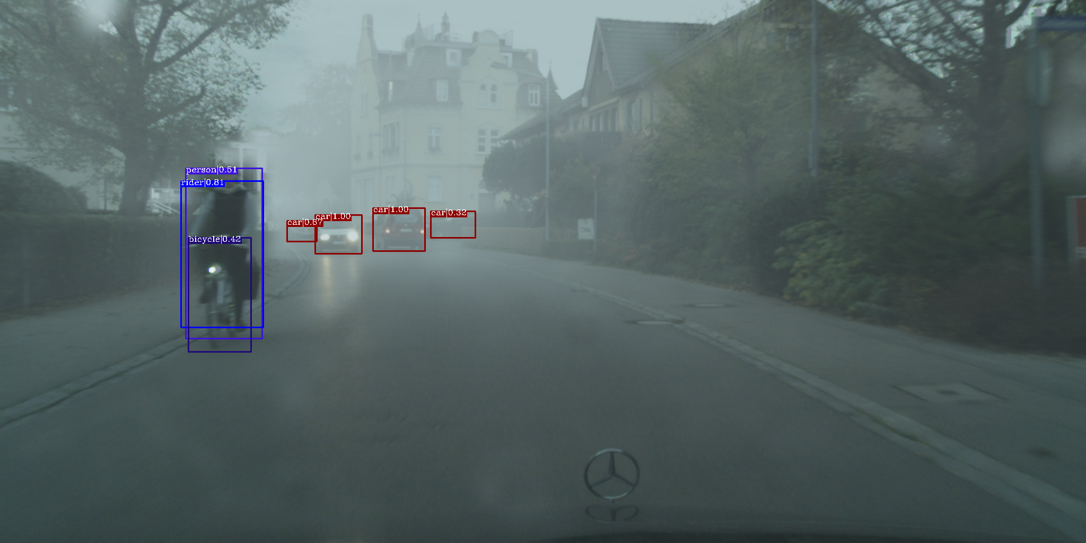
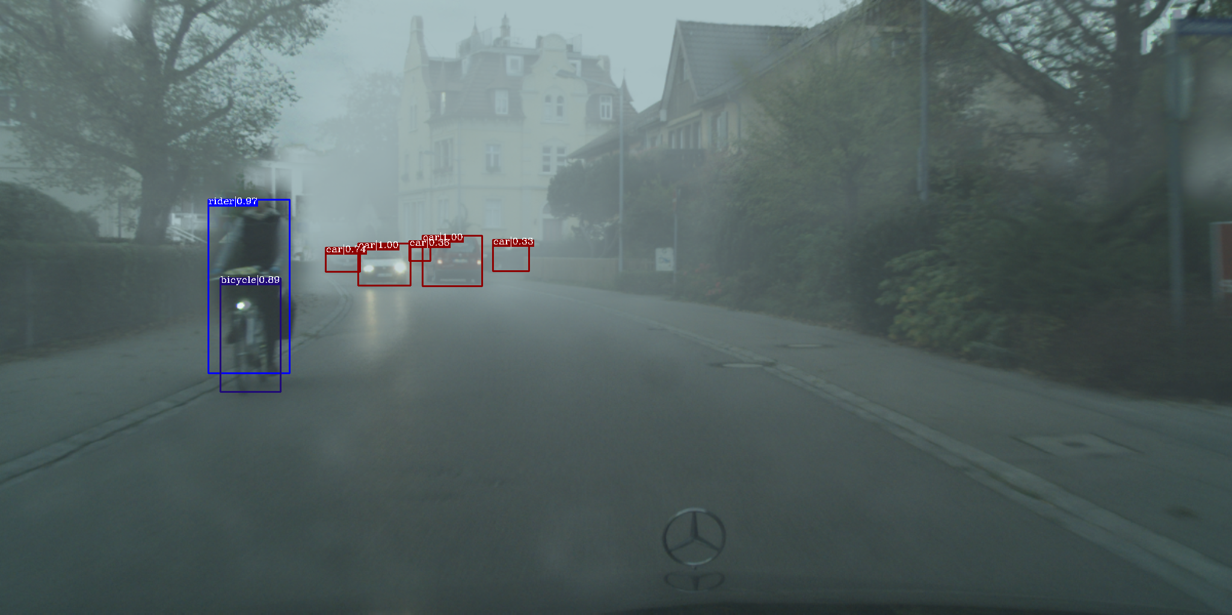
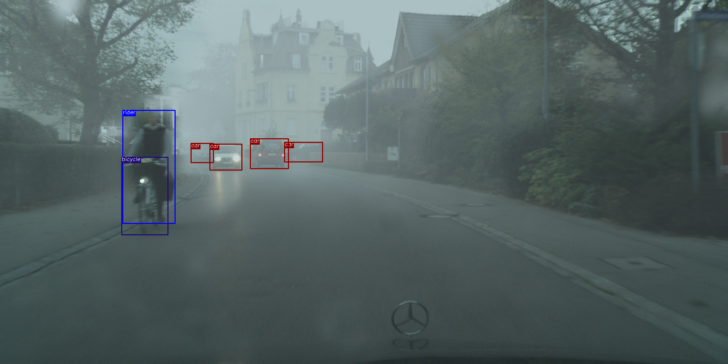
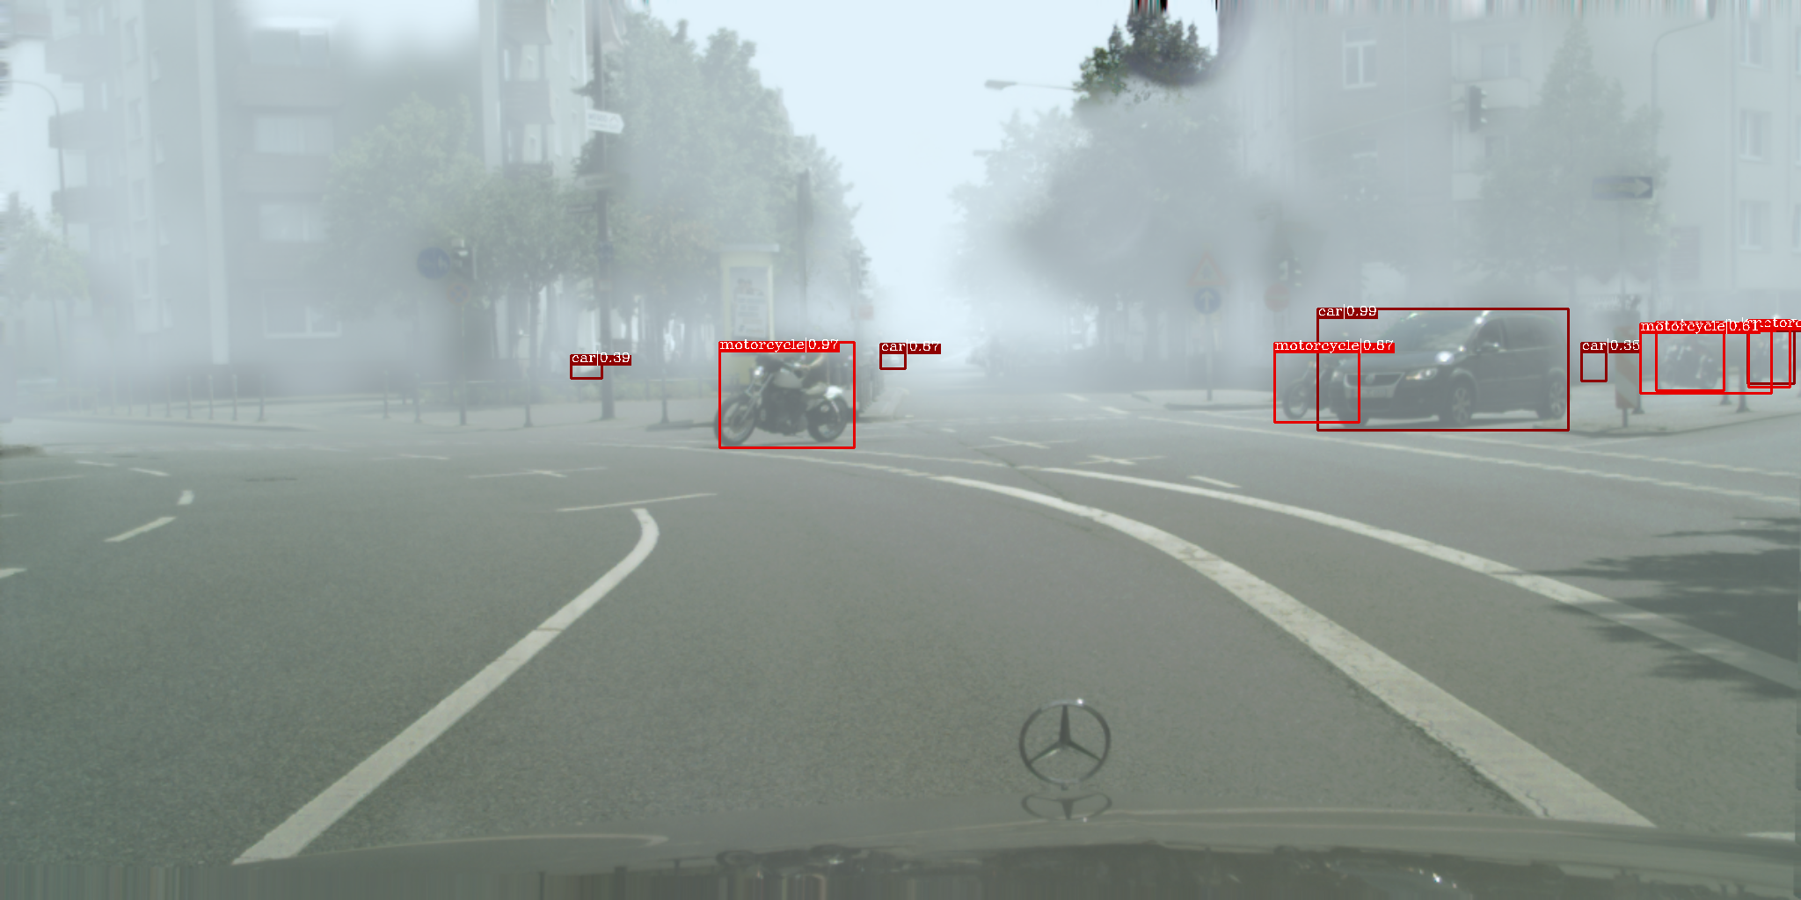
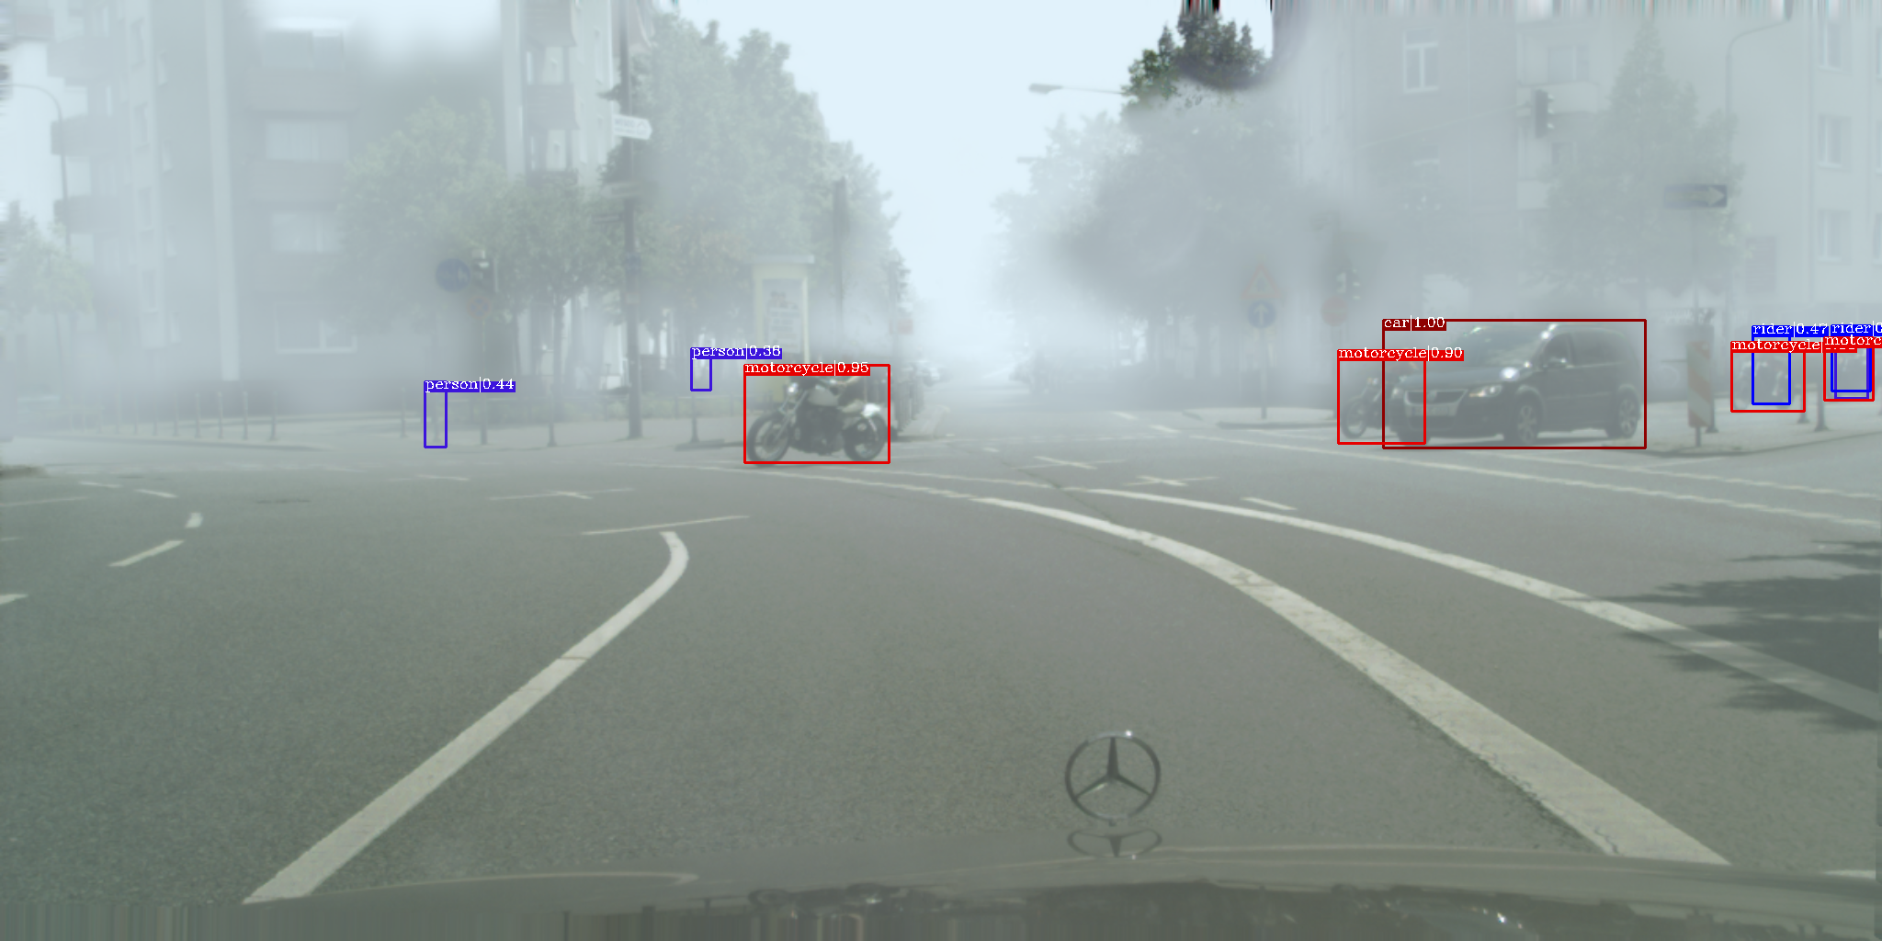
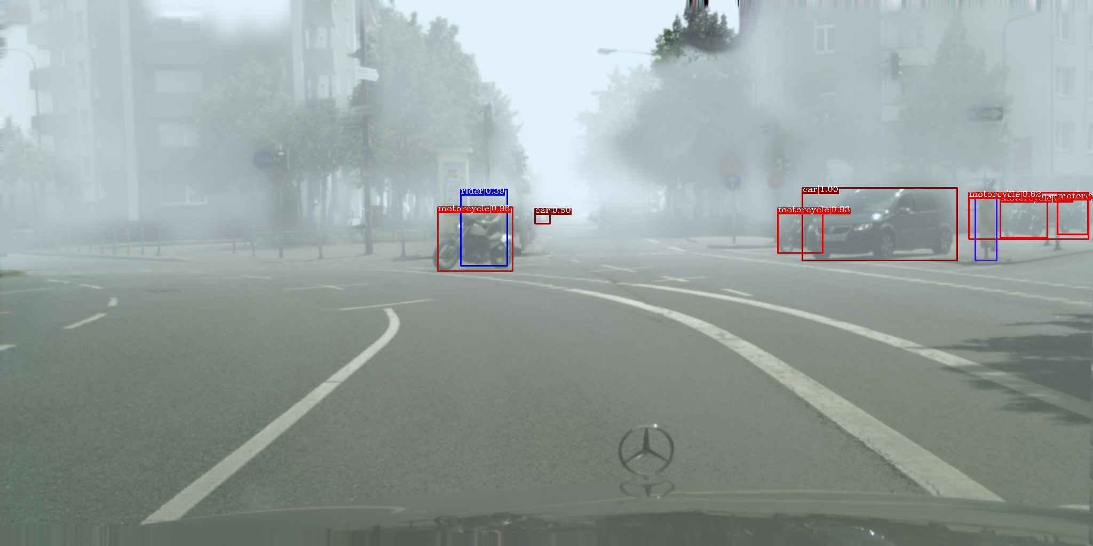
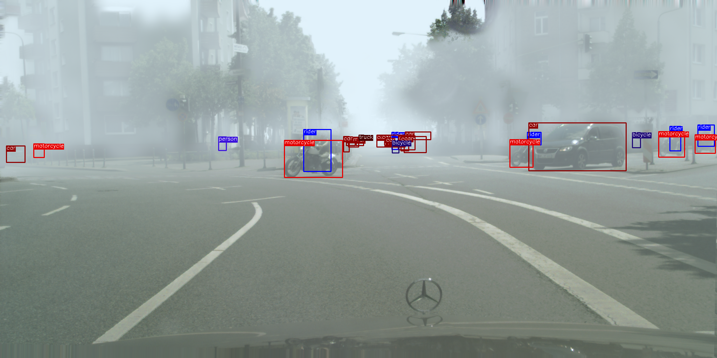
Experiments for Cross Domain Object Detection
Qualitative detection results on Normal-to-Foggy
Input
CycleGAN
DRIT
ForkGAN
CUT
DCLGAN
PPDCLUIT
Ground Truth

Slide 15
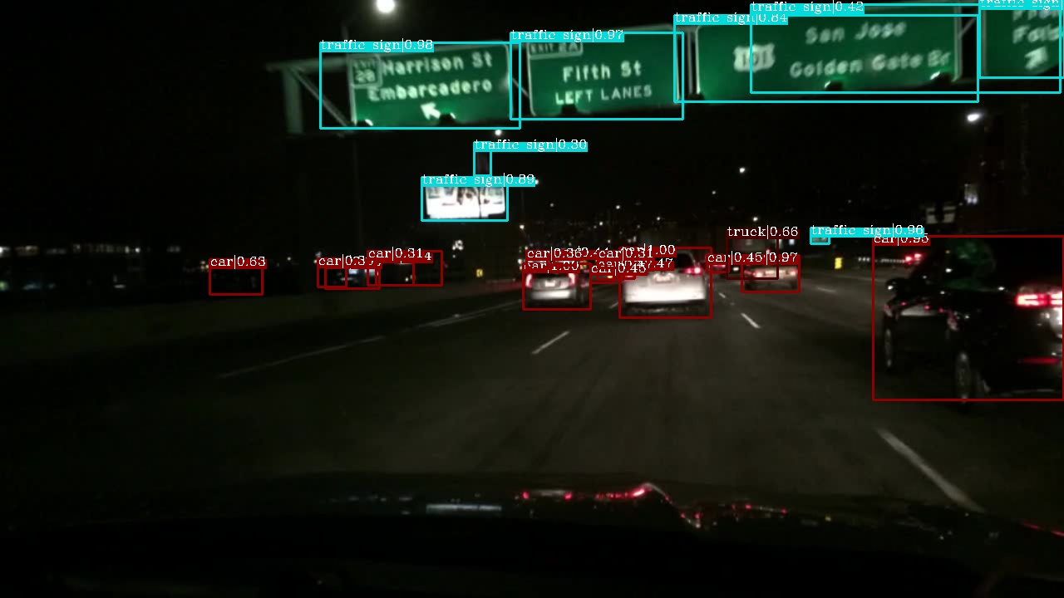
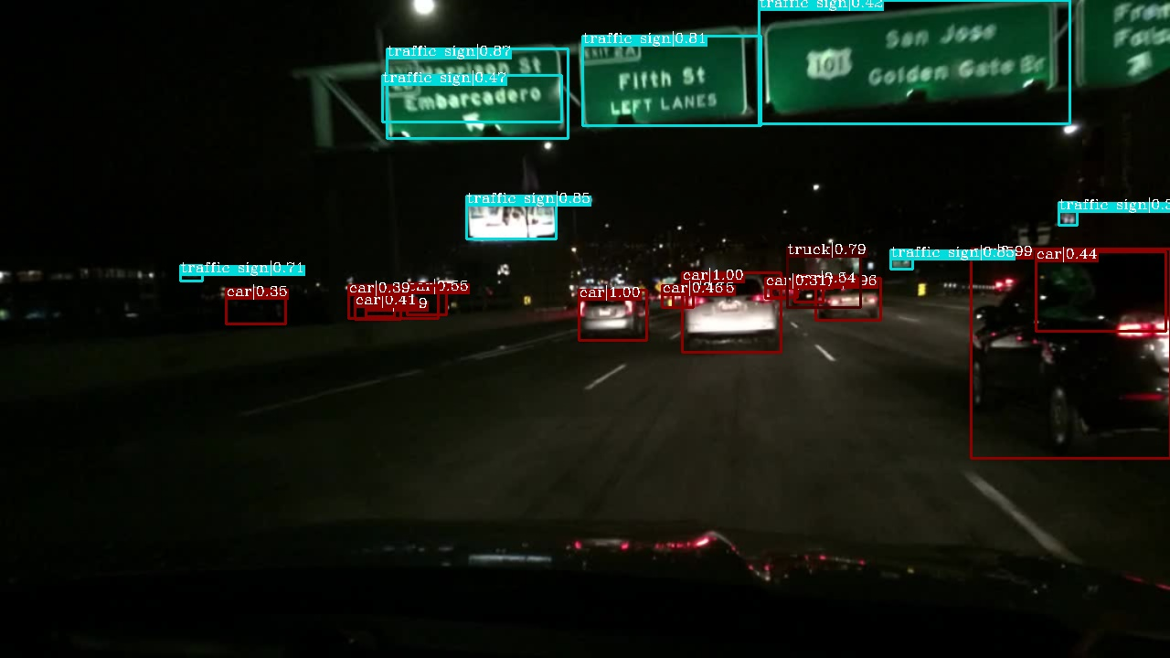














Experiments for Cross Domain Object Detection
Qualitative detection results on Day-to-Night
Input
CycleGAN
DRIT
ForkGAN
CUT
DCLGAN
PPDCLUIT
Ground Truth

